Slide 1




Raindrops on a Tin Roof: Exploring the Cyberinet
Matthew A. Bardin - PHD Candidate
Louisana State University - Experimental Music & Digital Media
04/18/2023

Slide 2
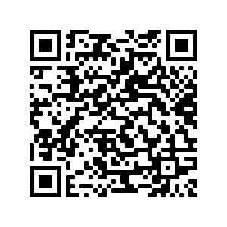
The main event will begin soon. Please take your seat. Access the event program, various examples and music scores with this QR code.
1
Notes:
Greeting
Introduce myself
Mention Streaming and online resources

Slide 3
Raindrops on a Tin Roof: Exploring the Cyberinet
Matthew A. Bardin - PHD Candidate
Louisana State University - Experimental Music & Digital Media
04/18/2023
Notes:
Greeting
Introduce myself
Mention Streaming and online resources
Be Sure to mention that this is an augmented Instrument

Slide 4

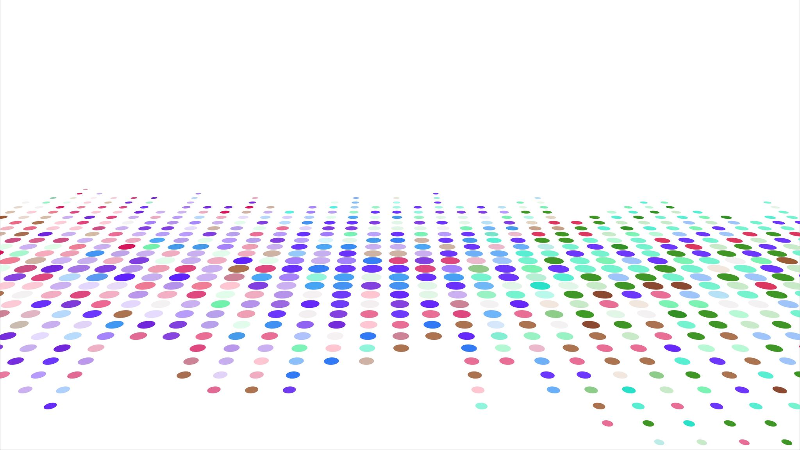
Augmented Instruments
What is the Cyberinet?

Slide 5
What is an Augmented Instrument?
Augmented Instruments are any instrument that has been altered or enhanced from its base capabilities in some way.
This can be done in a variety of methods.
Augmentation methods can be any combination of manual, automatic, acoustic, mechanical, or electronic.
Many modern augmentations include electronic components, sensors and computers.
Reid, Sarah, Sithi-Amnaui, Sara, & Kapur. Ajay. (2018). Women who Build Things: Gestural Controllers, Augmented Instruments, and Musical Mechatronics. Proceedings of the International Conference on New Interfaces for Musical Expression, 178-183.

Slide 6
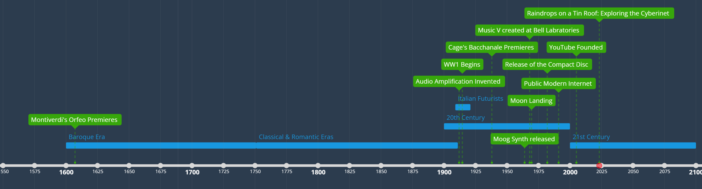
Recent Eras of Augmented Instruments
Pre-20th Century
20th Century
21st Century (so far)
Completely acoustic/mechanical.
Generally looking to improve an instrument or crate a new one.
Brass Mutes, Player Pianos, Calliope.
Early electronics improve over course of century
Early computer augmentations begin to appear.
Prepared Piano, Amplification, Effect Pedals, Recording Developments.
Largely computer-based.
Exploring new timbres and instrument functionality with new technology.
Cyberinet, MIGSI Trumpet, SABRe, Overtone Violin, MataSax.
Notes:
Prepare for lots of questions about this
Begin with the idea of improving the capabilities of instrument
Seeking new and altered timbres
Futurists seek to create and explore new sounds in music
Electrical alteration
Many new augmented instruments focus on this idea of improving an instruments’ features and timbres. Many of these include modern technology.
End with “How does the Cyberinet fit into the history of Augmented Instruments?”

Slide 7
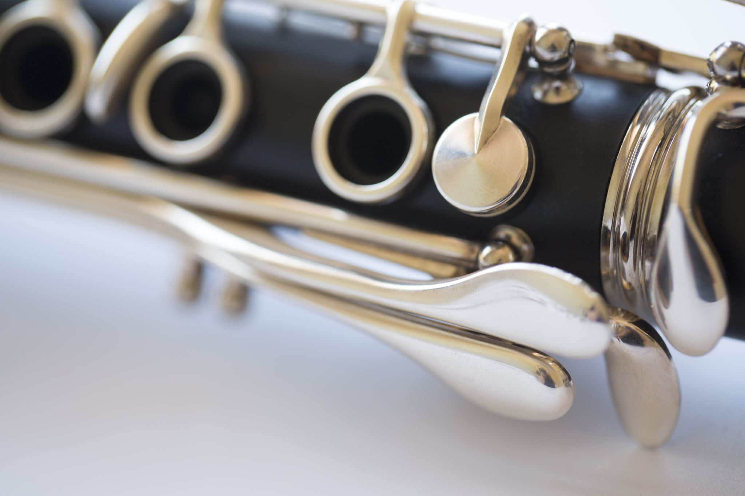
Cybernetic + Clarinet
Notes:
The Cyberinet utilizes Cybernetic concepts and technology to Augment the Clarinet
Cyberinet = Cybernetic + Clarinet

Slide 8
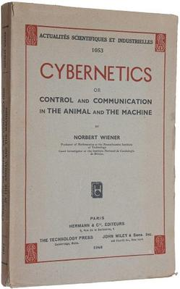
What are Cybernetics?
Cybernetic: The science of communications and automatic control systems in both machines and living things – Oxford Dictionary
Definition ca. 1948 from the Greek “Kubernetes” meaning captain, pilot, conductor, etc.
Norbert Wiener first defined the term in his book Cybernetics: Or Control and Communication in the Animal and the Machine. It came from the concept of a sailor steering a ship, then seeing the ship move and responding to that in a feedback loop.
Later refined to: Circular causal and feedback mechanisms in biological and social systems.
Cyborg: portmanteau of cybernetic and organism. A being with organic and inorganic body parts. (ca. 1960)
Many crossovers and definition variances stemming from the core concept of automated control and feedback loops.
The Cyberinet is used to collect performance data and automatically control the audio processing and other electronic elements of an electroacoustic performance.
Notes:
Story about turning a wheel to move a boat and avoid rocks

Slide 9
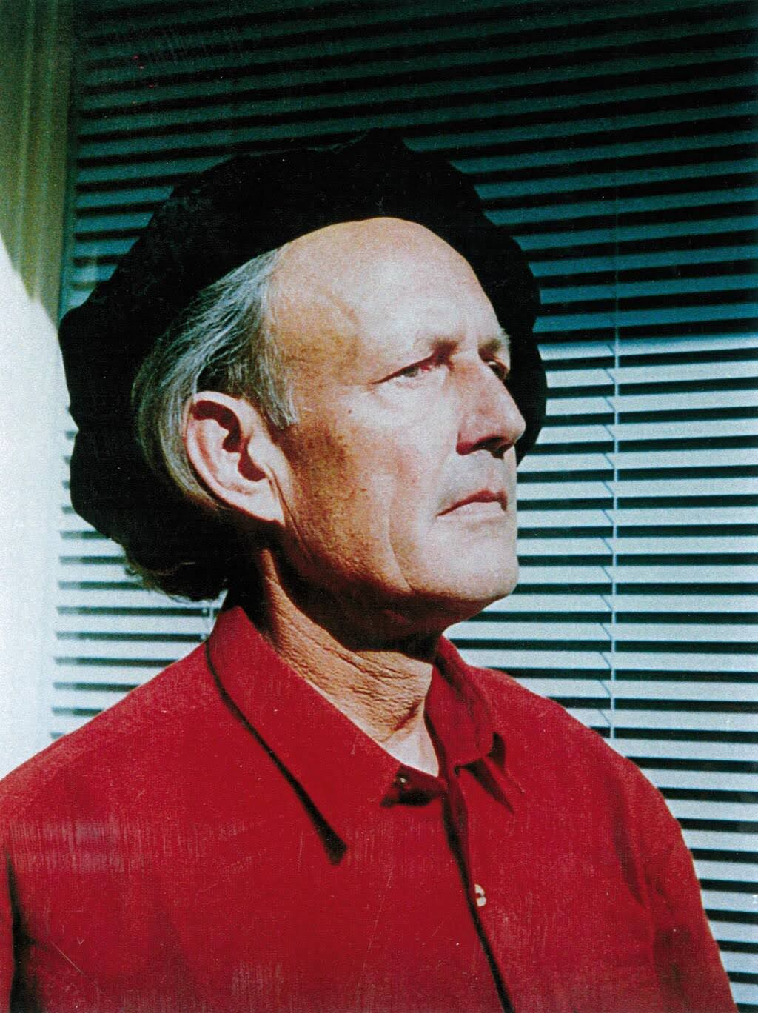
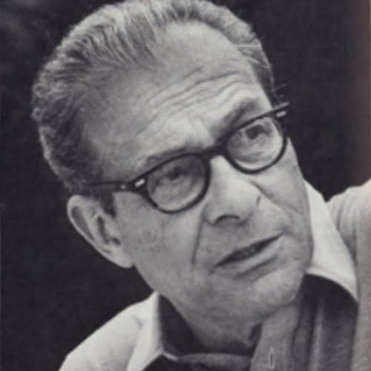
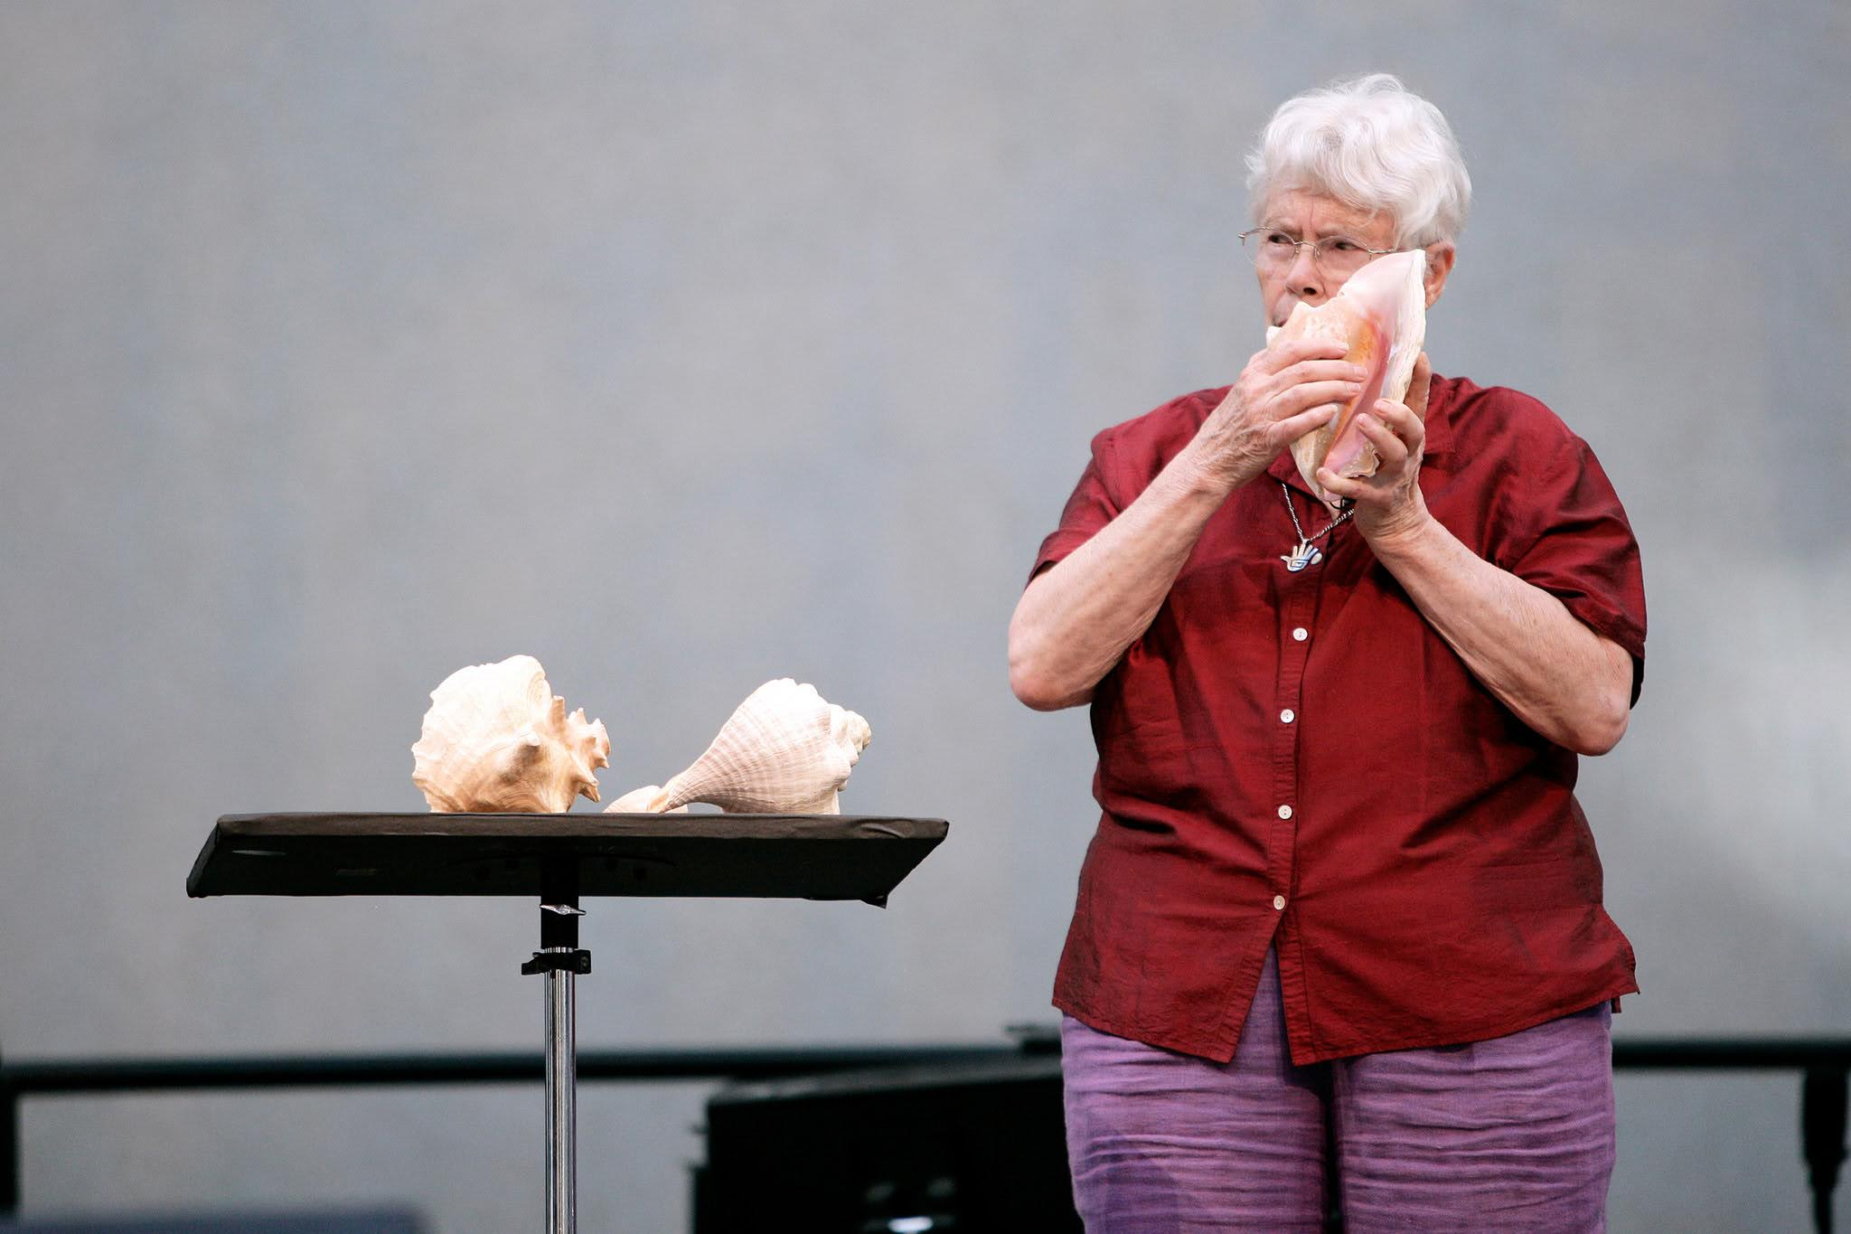
Cybernetic Music
Several composers have utilized cybernetics in some way in their music. A small sample includes:
Roland Kayn (1933-2011):
Composer focusing on Cybernetic Concepts and electronics.
Mix of random and intentional aspects.
Allows the sound to grow and evolve on its own.
Herbert Brün (1918-2000):
Composer and computer scientist.
Utilized early computing languages in the creation of new music.
Creates new timbre synthesis techniques similar to granular synthesis.
Pauline Oliveros (1932-2016):
Composer and post-war experimental musician.
Inspired by Cybernetic concepts in the 1960’s.
Led to experiments with sounds creating sounds, tape, and other methods of creating and listening to music.

Slide 10
How does the Cyberinet factor in?
The Cyberinet is a sensor array designed to be easily adapted the instrument for electronic music without impeding the performance of the instrument.
The Cyberinet can still be used as a regular clarinet barrel while powered off.
Utilizes cybernetic principles (automatic control of various sound processes) to create an augmented instrument.
Easily implement a feedback loop where the sound can effect the player making the sound.

Slide 11
Why use this Instrument?
Easy to implement.
Does not reduce the Clarinet’s capabilities.
Can easily add harmonic capabilities to the Clarinet.
Intuitive controls.
Can be used by performers, composers, and programmers.
Notes:
More practical/artistic

Slide 12

Creating the Cyberinet
Notes:
We know what it is, now lets look at how its made.

Slide 13
OEM Components OEM Components are standardized to be compatible with each other.
The Cyberinet is comprised of a main unit and smaller secondary unit.
Main Unit:
1200mAh Li-Po battery to power the device.
TP-4056 Type C board. (controls the charging and power distribution)
MPU-6050 board. (6 axis gyroscope and accelerometer)
SDP-31 Qwiic Connect board. (differential air pressure/flow and temperature)
ESP-32 DEVKIT board. (microcontroller and transmitter)
Secondary Unit:
2 momentary switches with independently programmable LEDs.
Also, the Cyberinet has 2 programmable LEDs, which are not OEM.
Notes:
Keep this slide short. Spend more time on the images slide.

Slide 14
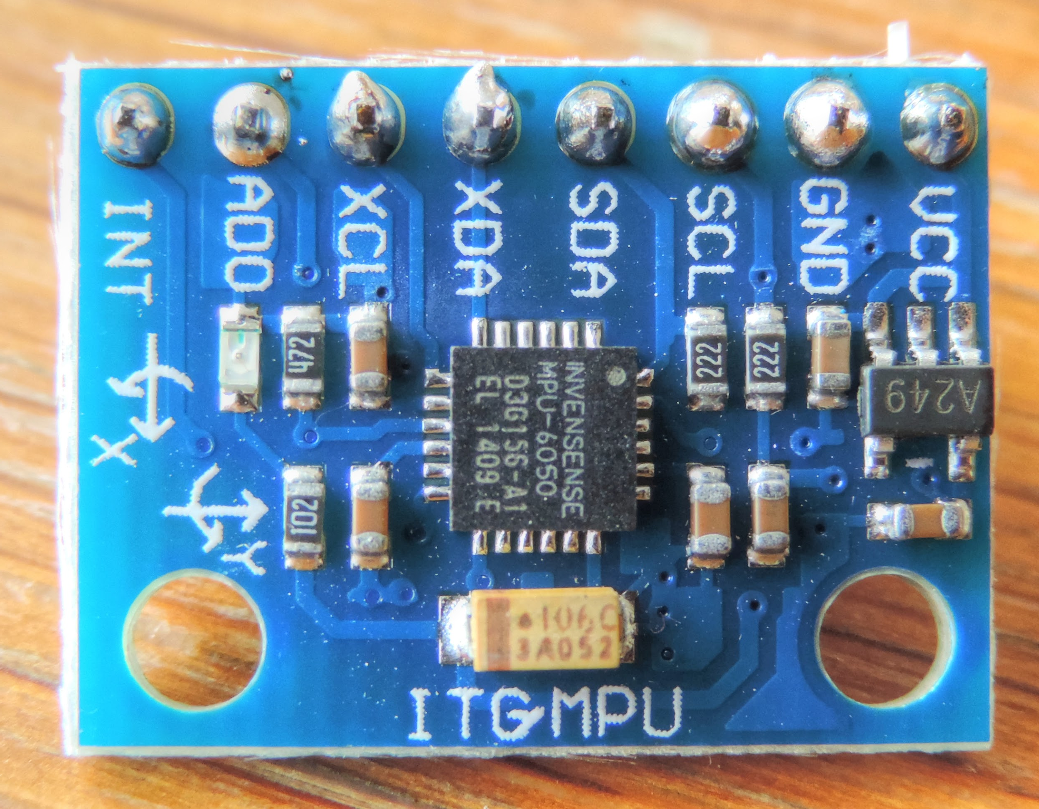
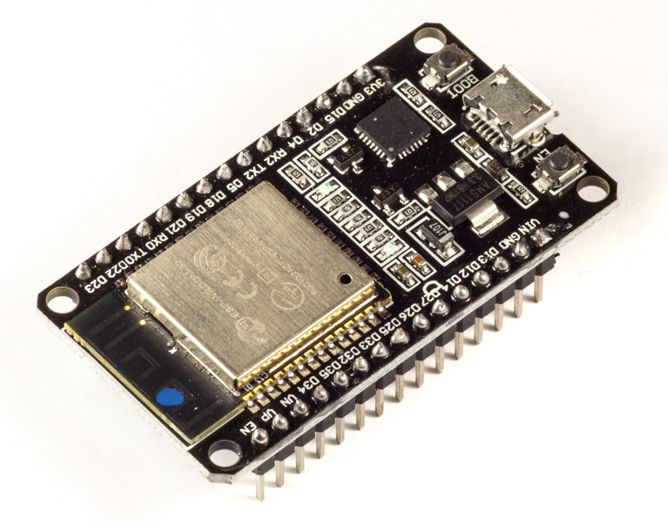
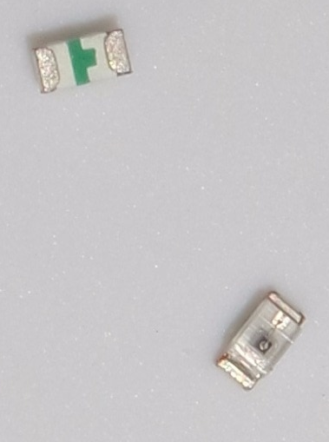
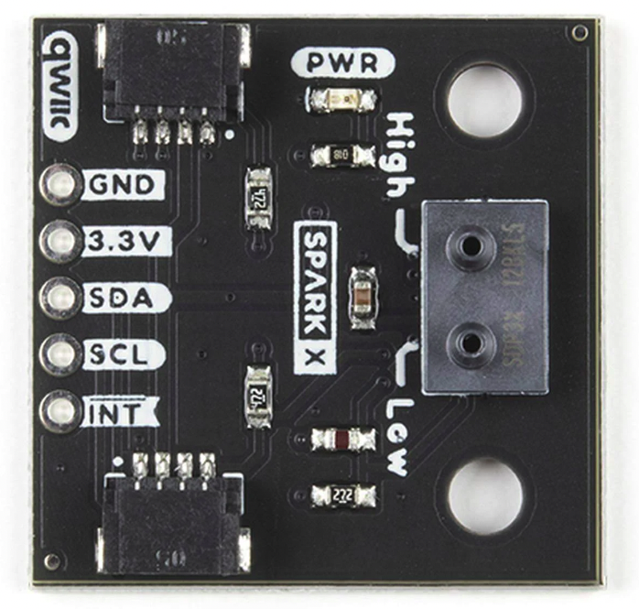
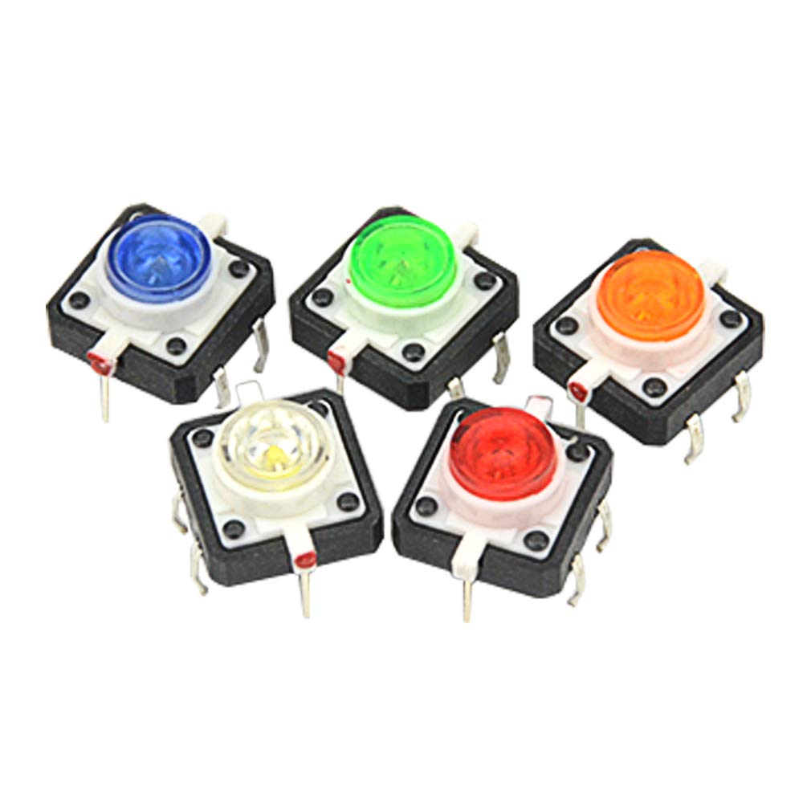
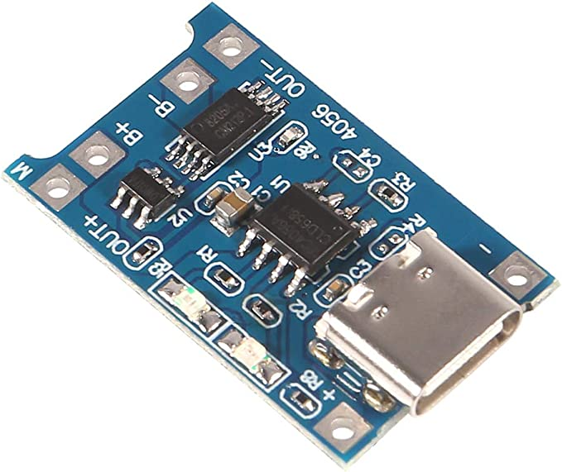
0602 Size SMD LEDs
MPU 6050 (Gyro + Accelerometer)
ESP-32 Microcontroller
SDP-31 Differential Pressure Sensor
TP-4056 (Power Distribution)
Pushbuttons
Version 1 Components
Notes:
Why were sensors chosen instead of other ones?
Gyro vs distance vs light etc.
They make sense for the physical act of playing clarinet

Slide 15
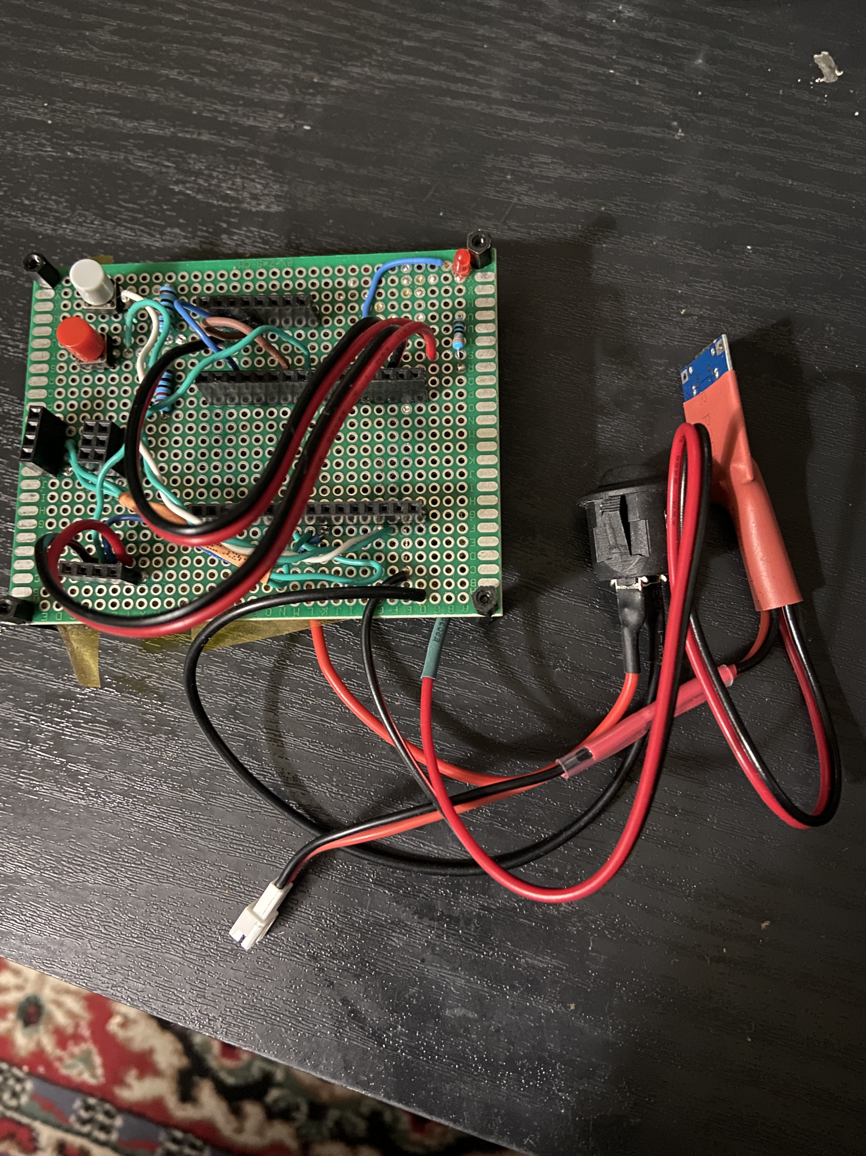
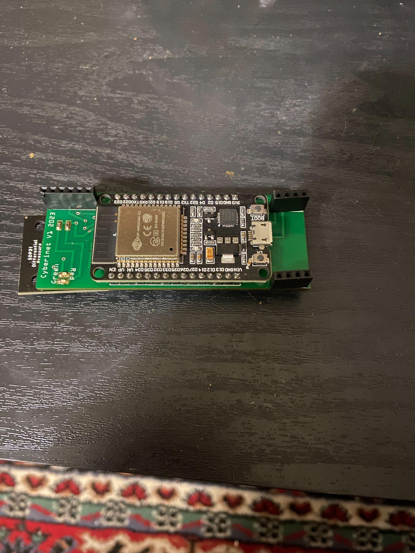
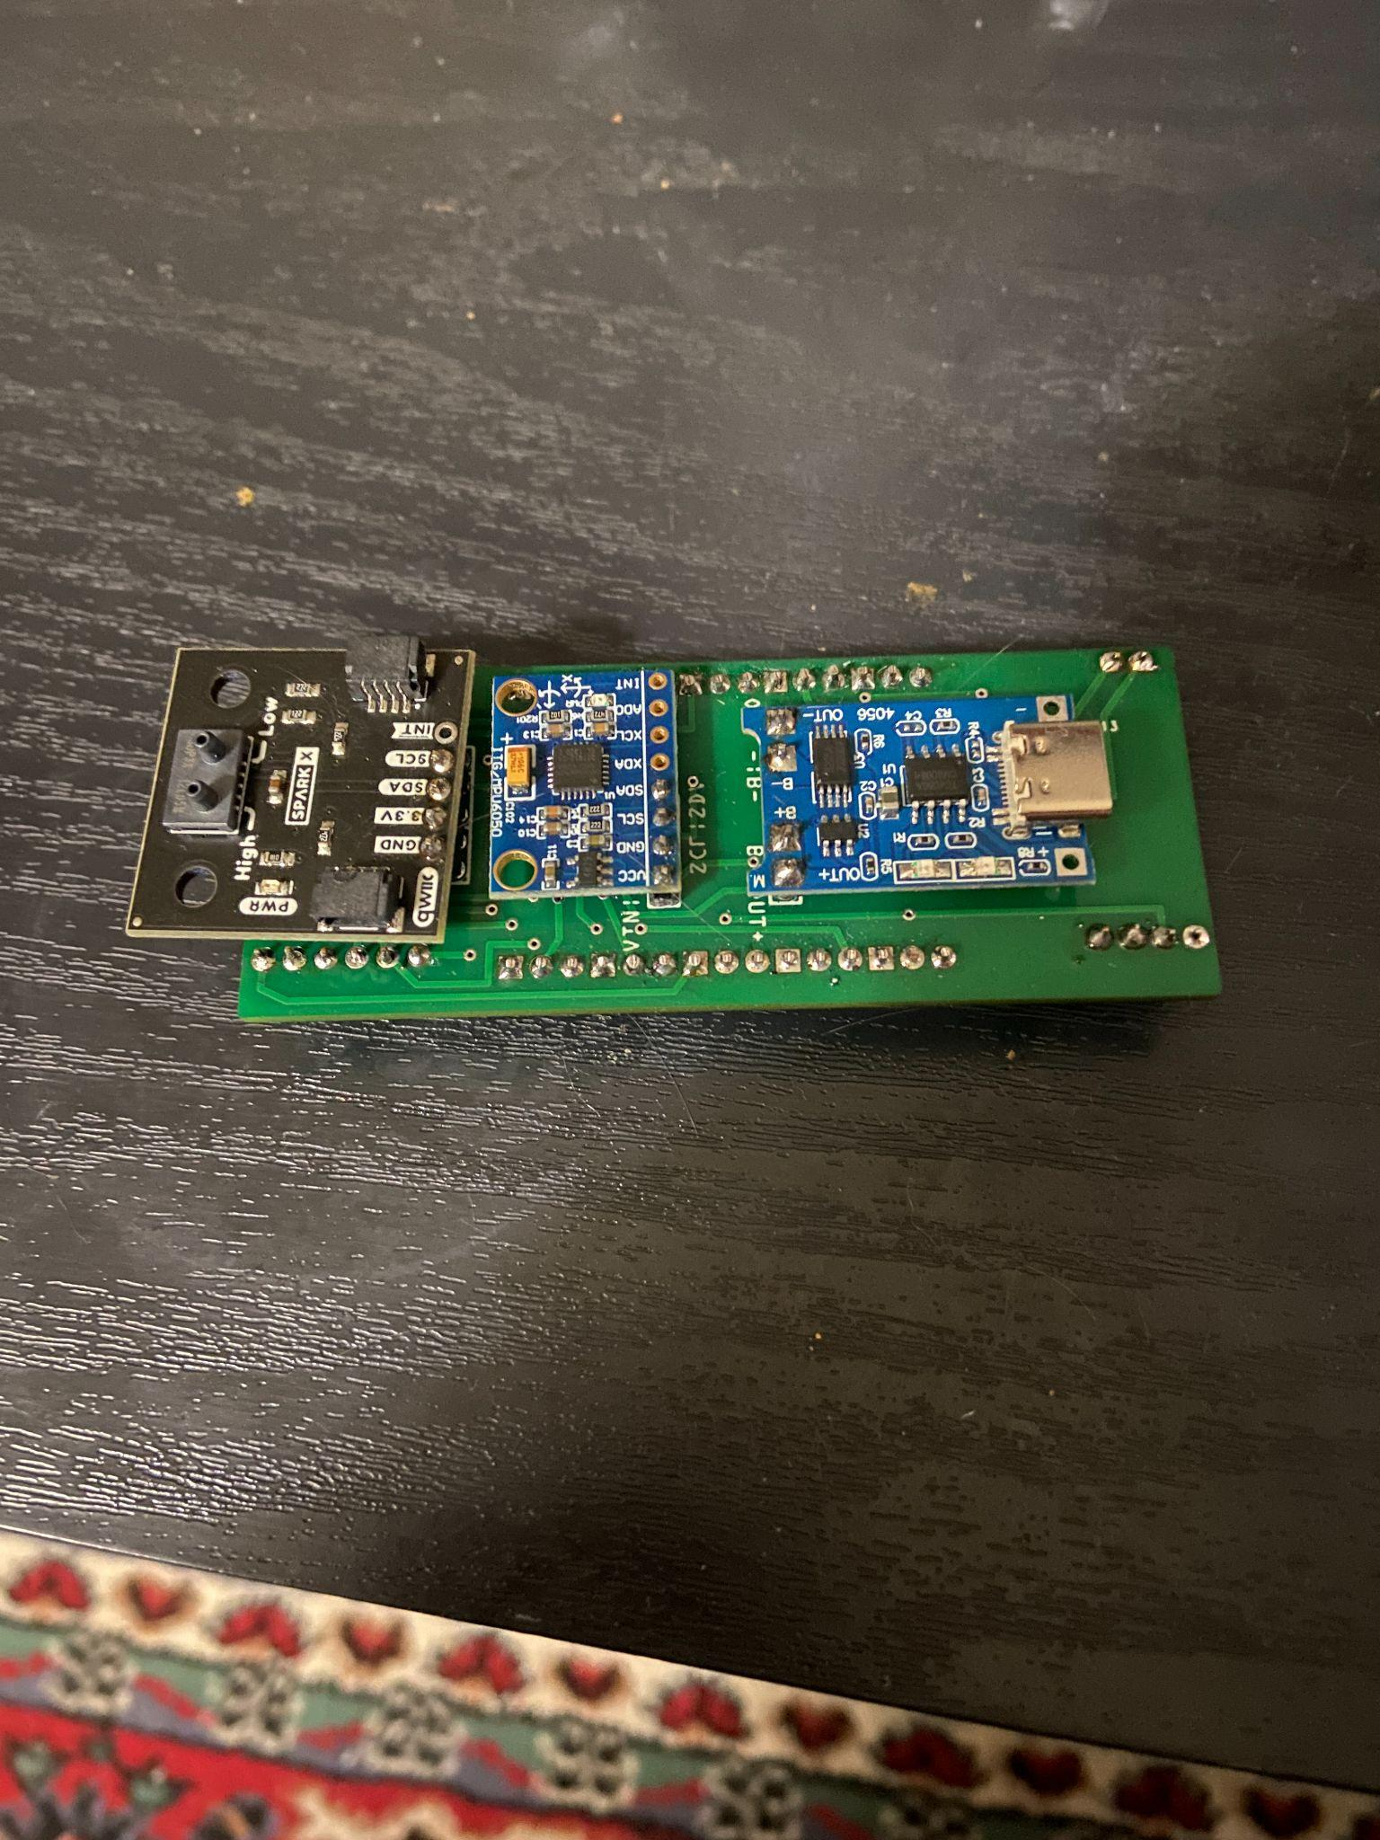
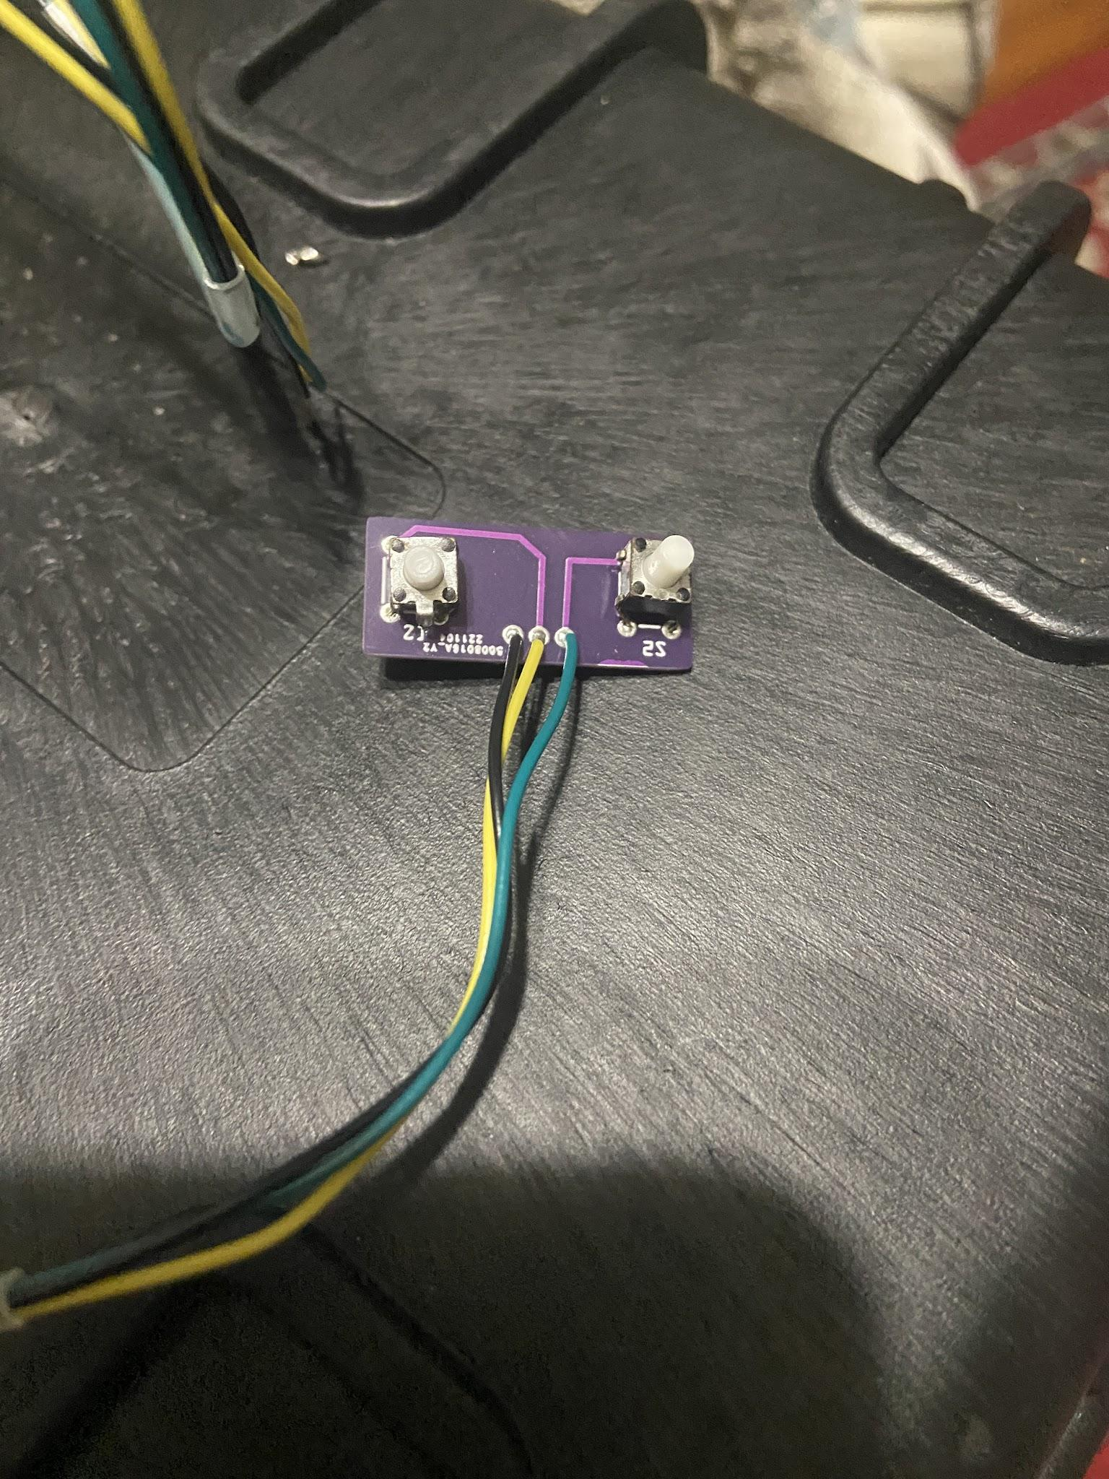
Top
Original Prototype Socket Board
Bottom
Buttons
Main Unit & Button Expansion Prototypes
Notes:
Didn’t start with these specific parts. Began on a breadboard and tested various components until I found ones I liked.
Big original hand made circuit board. Green is original printed version of the hand made circuit. Buttons are purple.

Slide 16
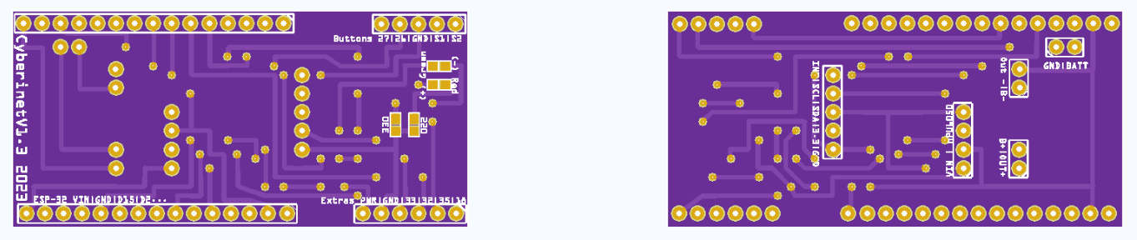
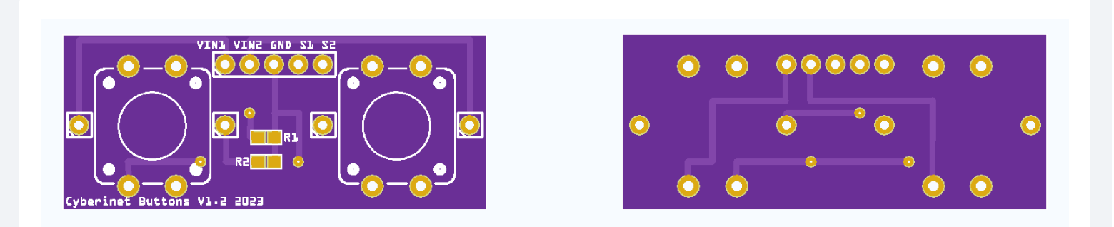
Main Board
Button Expansion
Version 1 Final PCB Diagrams
Notes:
Current PCB decision.
White outlines indicate which side the component is on.
Used to connect everything once they are soldered into place.
6 pins at bottom are used to connect to an optional expansion via USB C.

Slide 17
Future Optional add-ons
To further expand the functionality of the Cyberinet, multiple optional expansion units contain a variety of other sensors and can be utilized through the same expansion port.
These include:
Microphone
Finger pressure sensors
Secondary movement sensor
Speaker
All of these are still in development, with the microphone closest to being functional.

Slide 18

Music

Slide 19
Puzzle of a Park (2023)
All works heard today are the FIRST pieces written for this instrument.
Written to utilize the optional button add-on.
Performer triggers the on-stage microphone & playback of recordings with a single button.
Functions similarly to a loop pedal.
Allows performer to multi-track and harmonize with themselves.

Slide 20
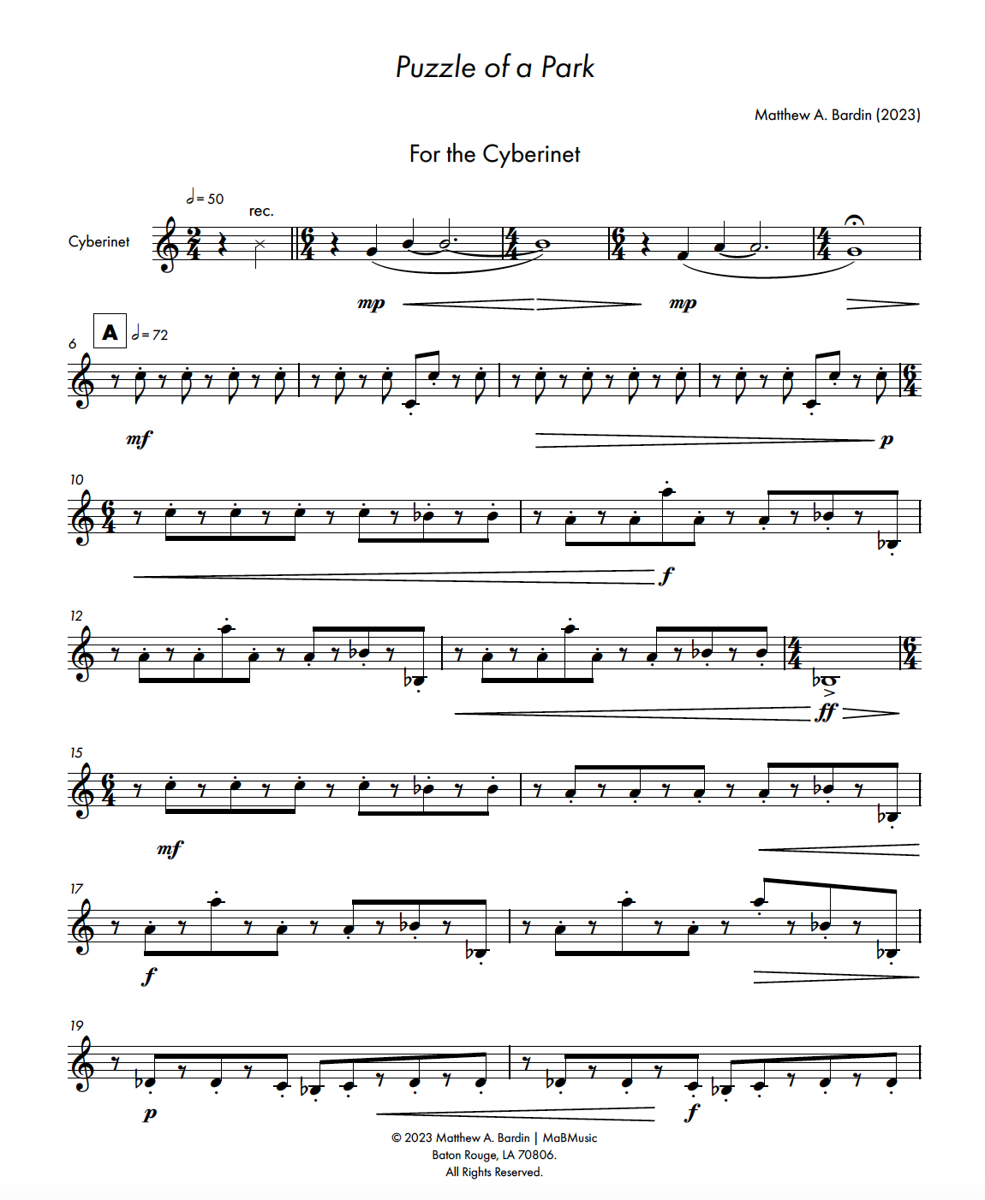
Adam Cope- Cyberinet
Puzzle of a Park opening page

Slide 21
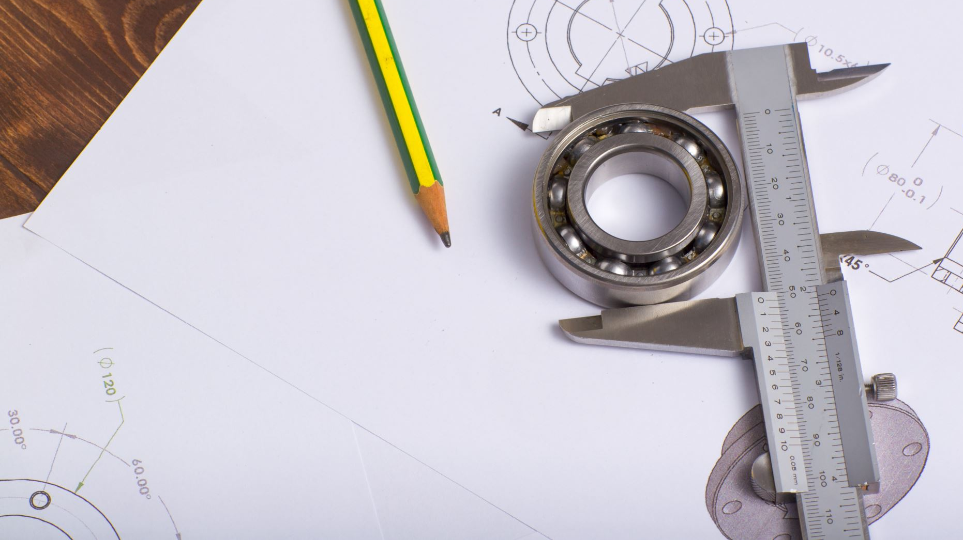
Assembling the Cyberinet

Slide 22
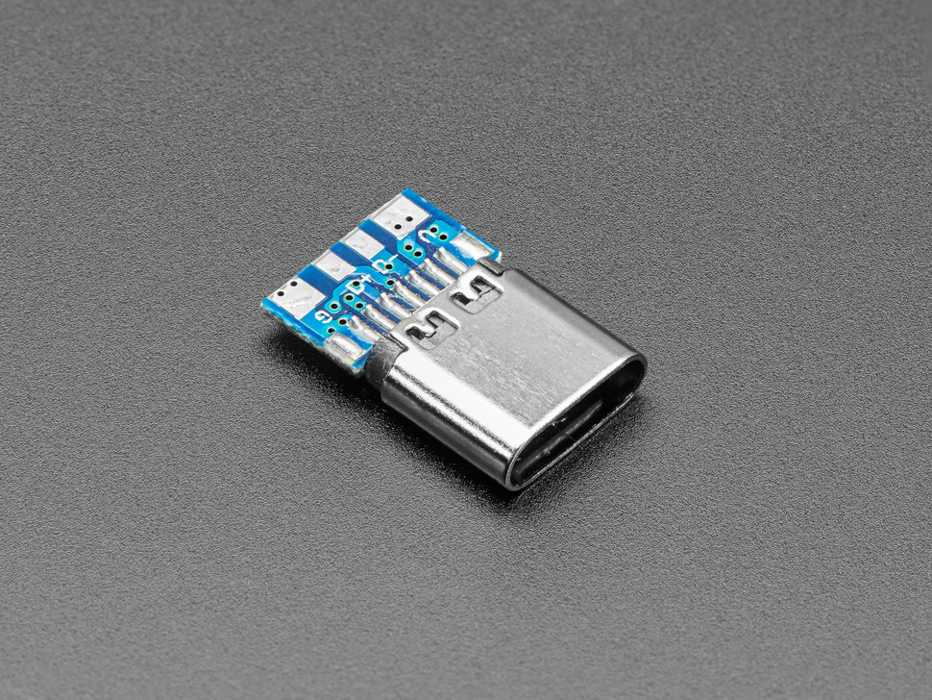
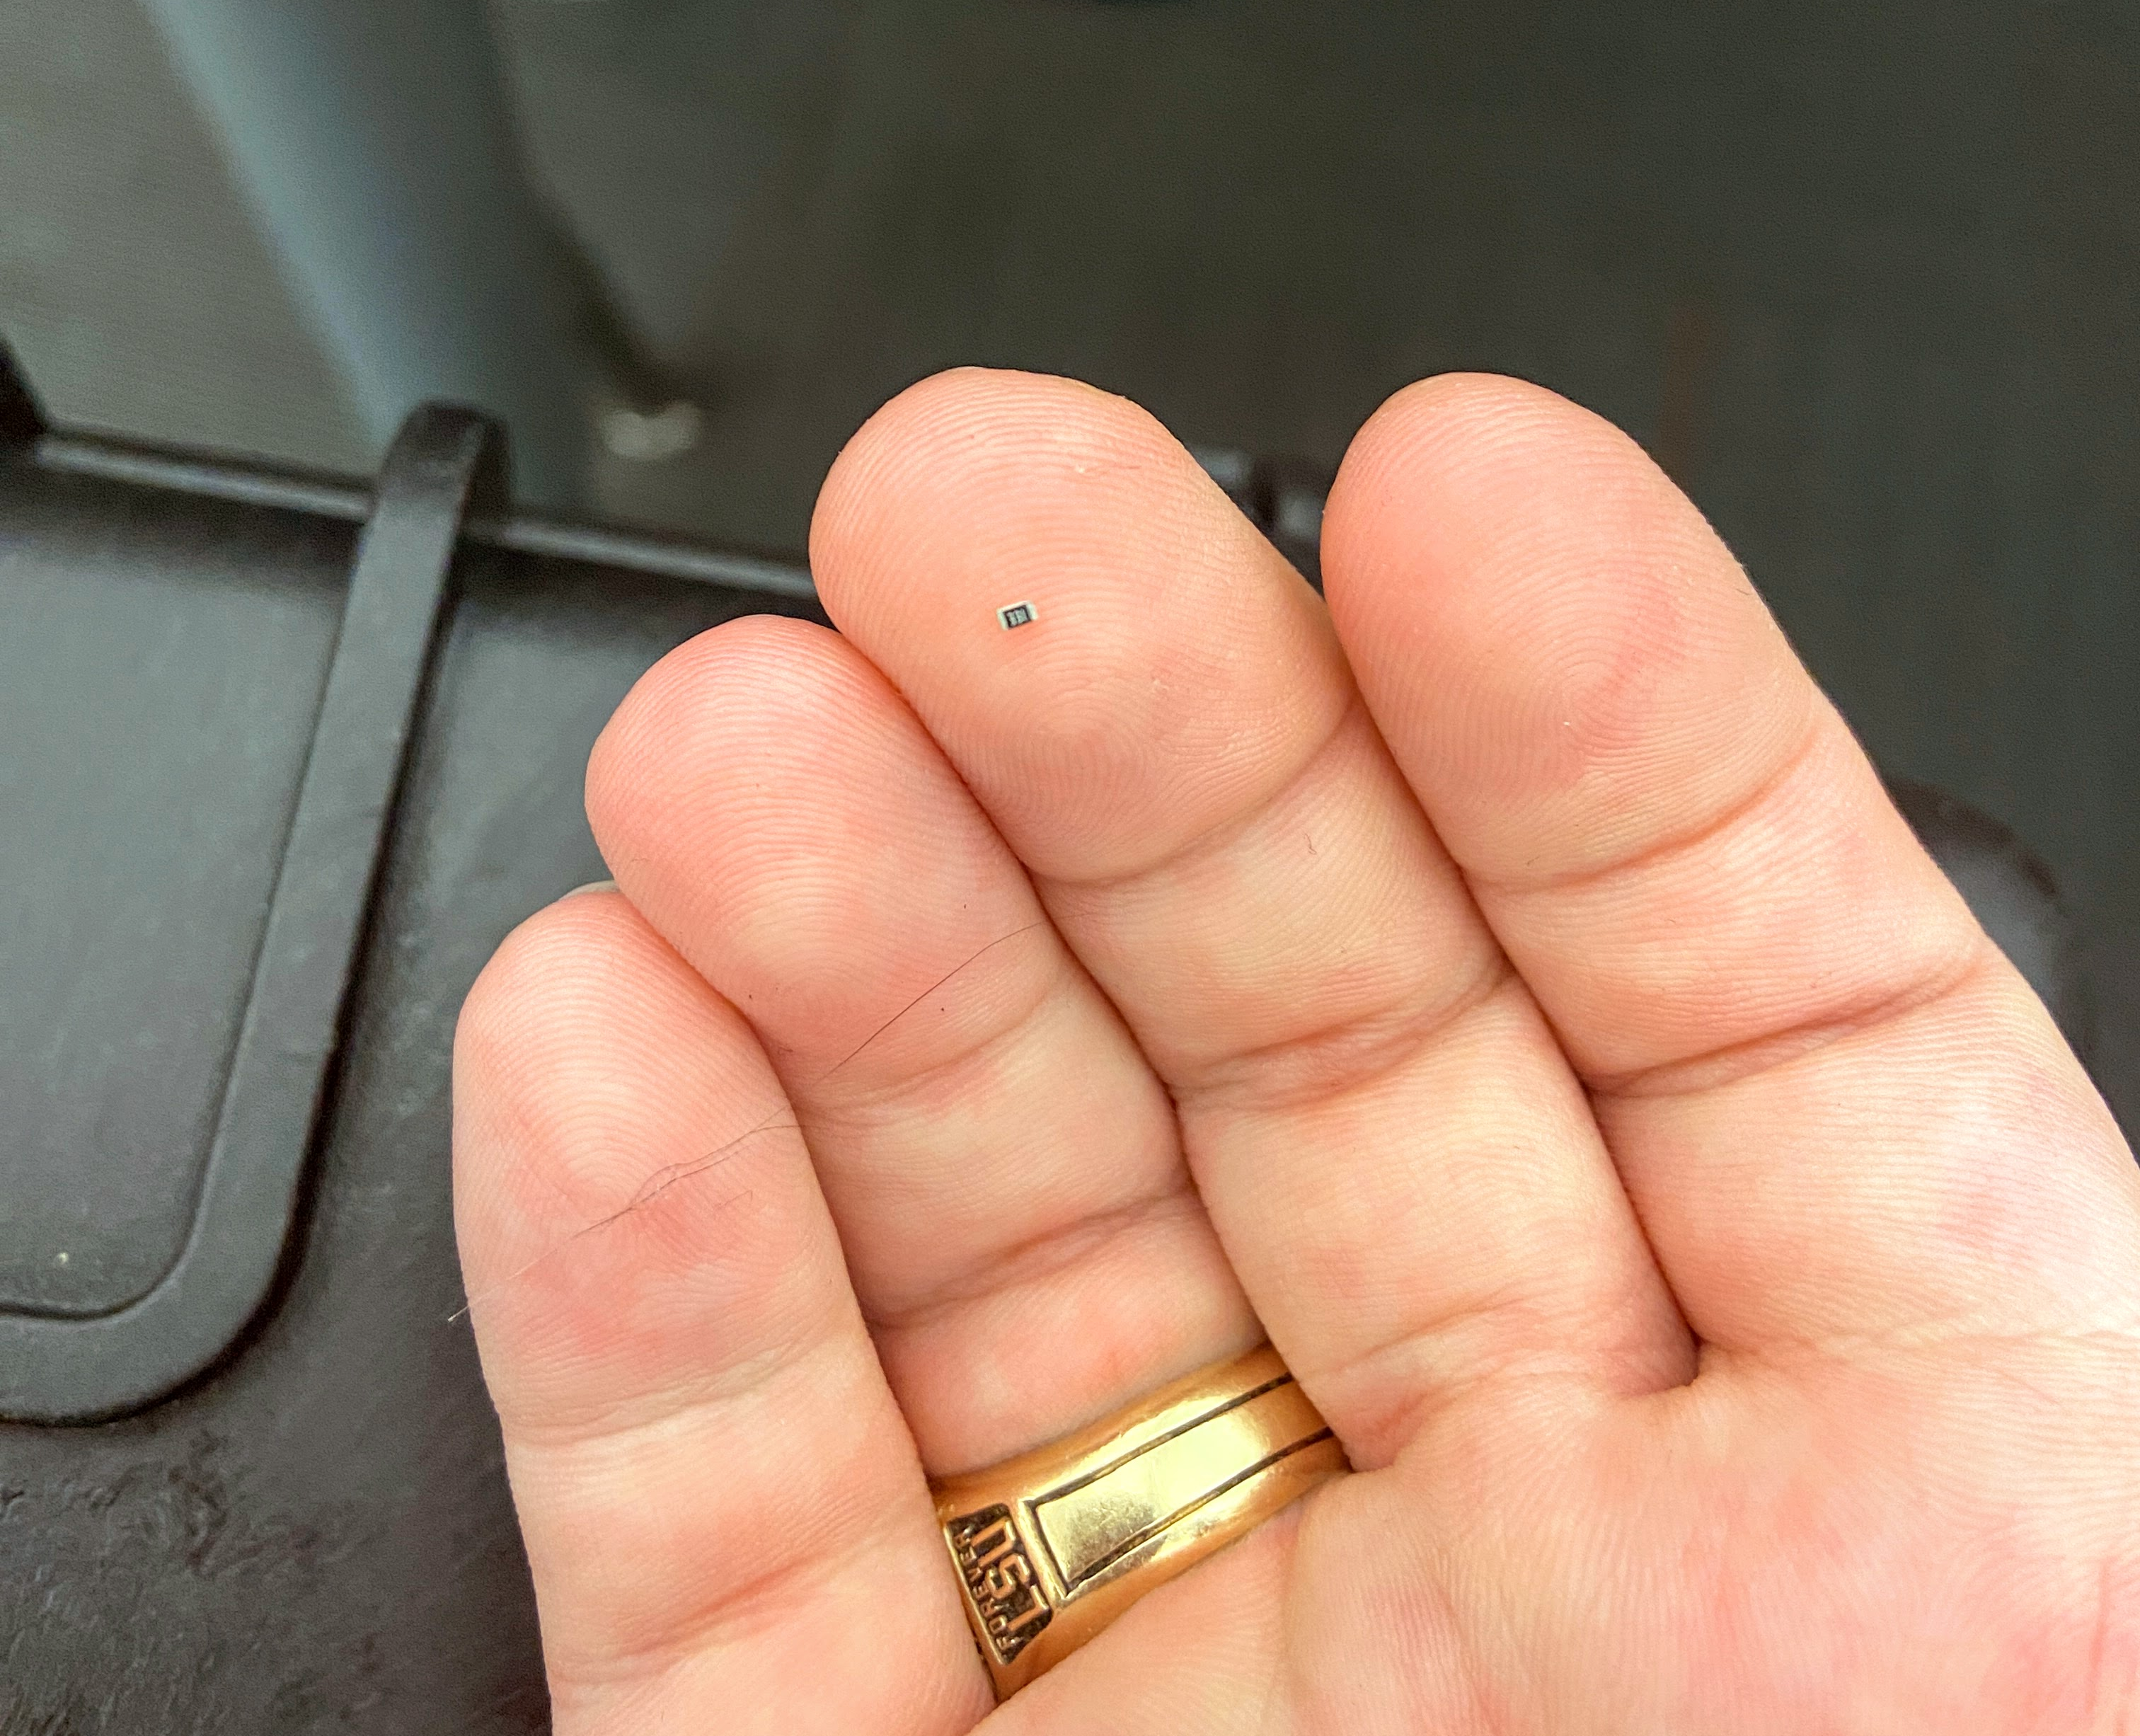
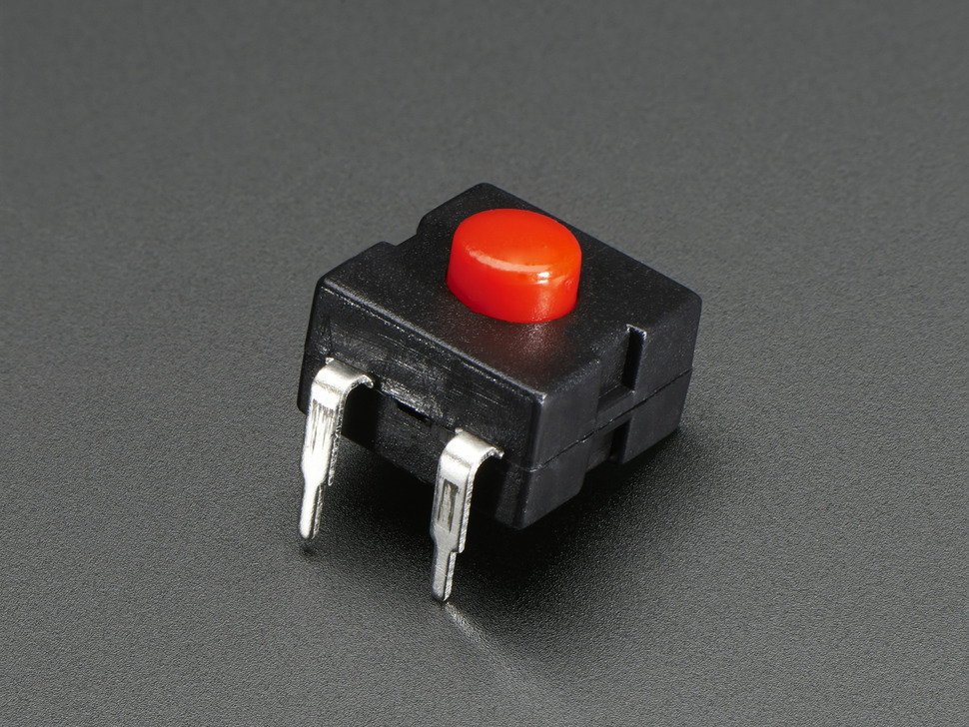
Assembling the Cyberinet
1:
Attach LEDs and Resistors (SMD Components) to the PCBs.
2:
Solder the USB-C and JST connectors. These are supported by the outer case.
3:
Solder the larger components directly to the PCBs. The microcontroller and SDP chip should be elevated with pin headers.
4:
Add the power switch. When done, connect the battery Glue/Sand as needed.
Notes:
Basically move from smaller to larger
Start with SMD
Be sure not to cover up areas I need to access with future components
Test each chip’s connection
Clip excess leads once connected.

Slide 23
Main Board
Button Expansion
Version 1 Final PCB Diagrams
Notes:
Just a quick reminder about these components going onto the main PCB
Keep o screen for les than 10 seconds

Slide 24
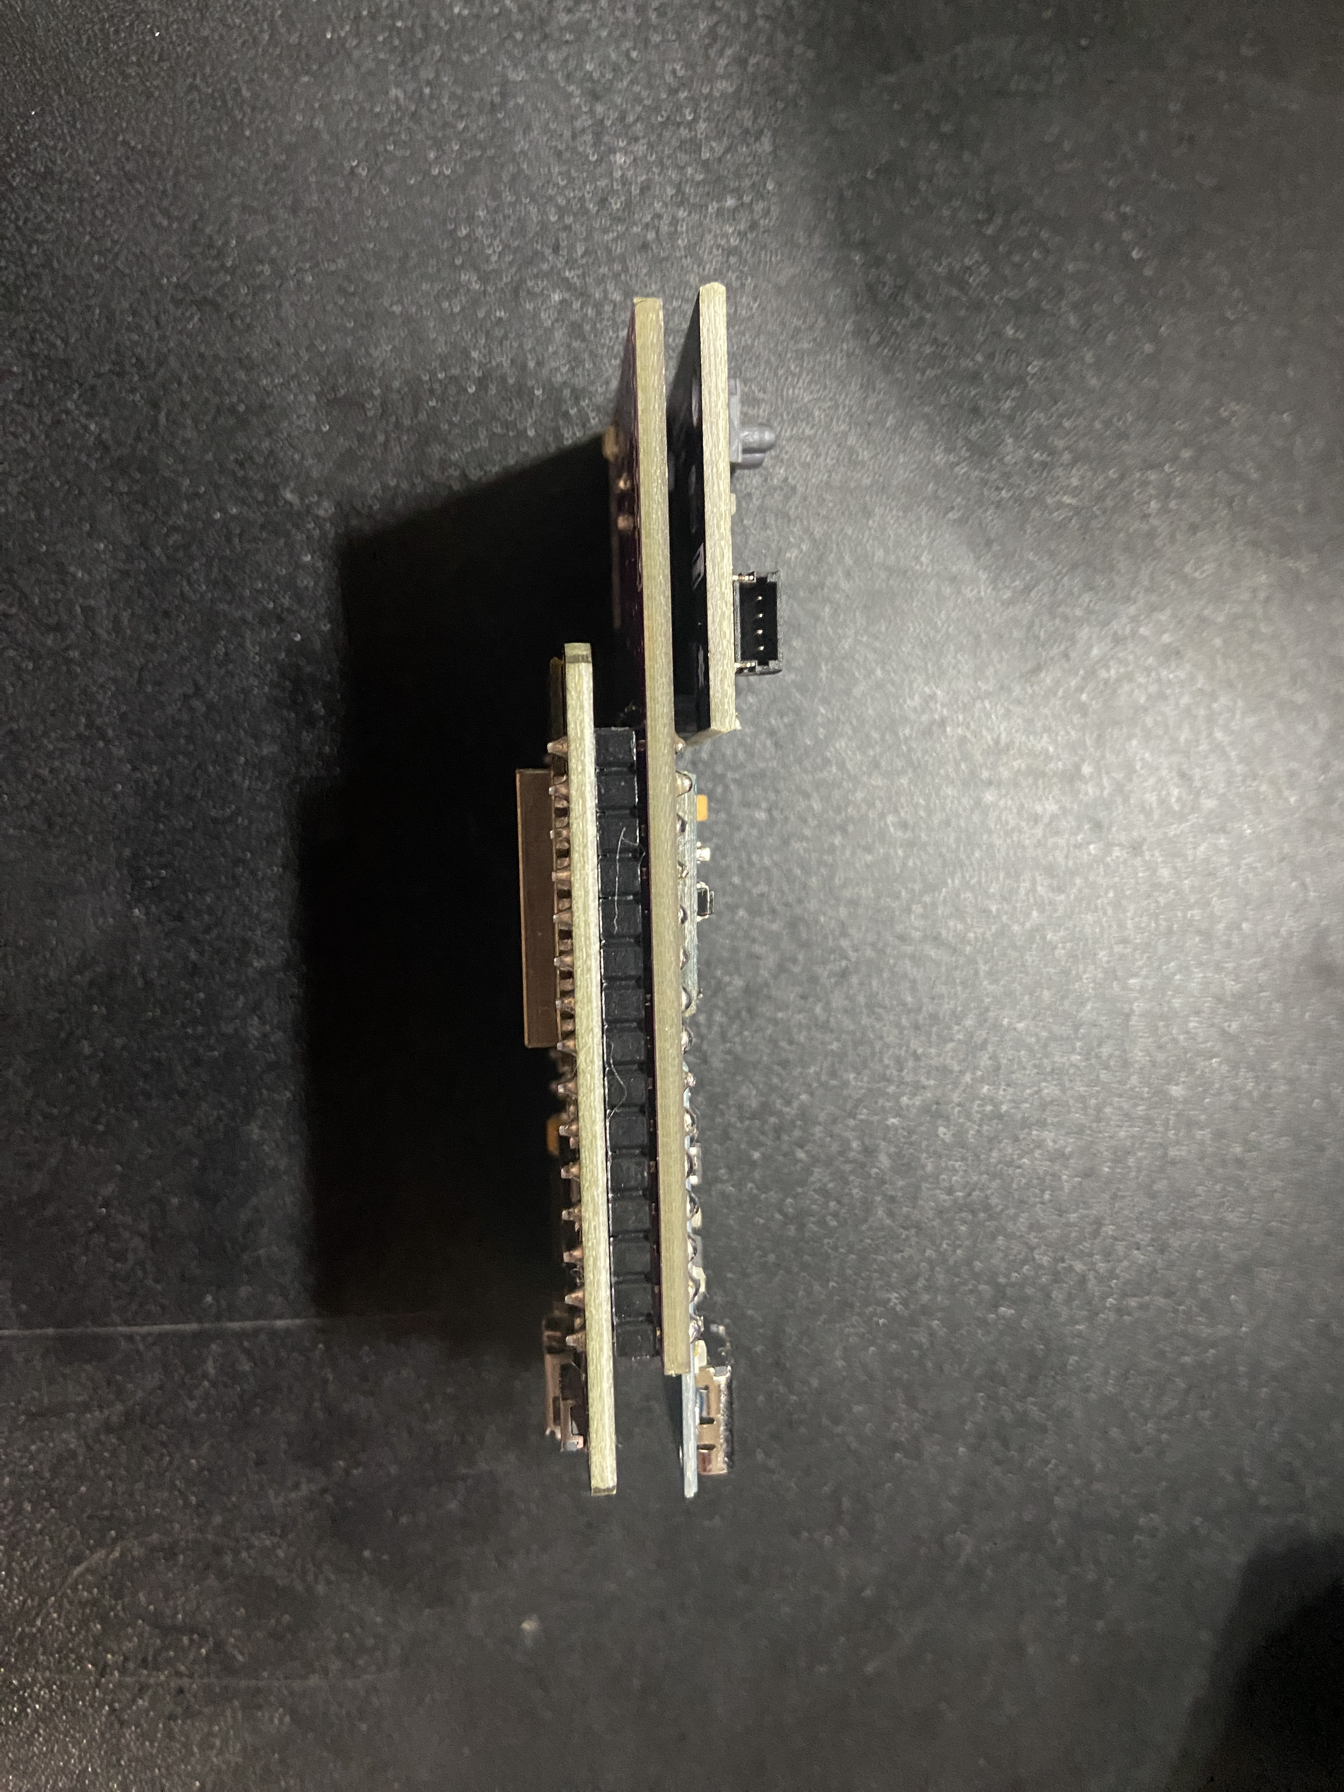
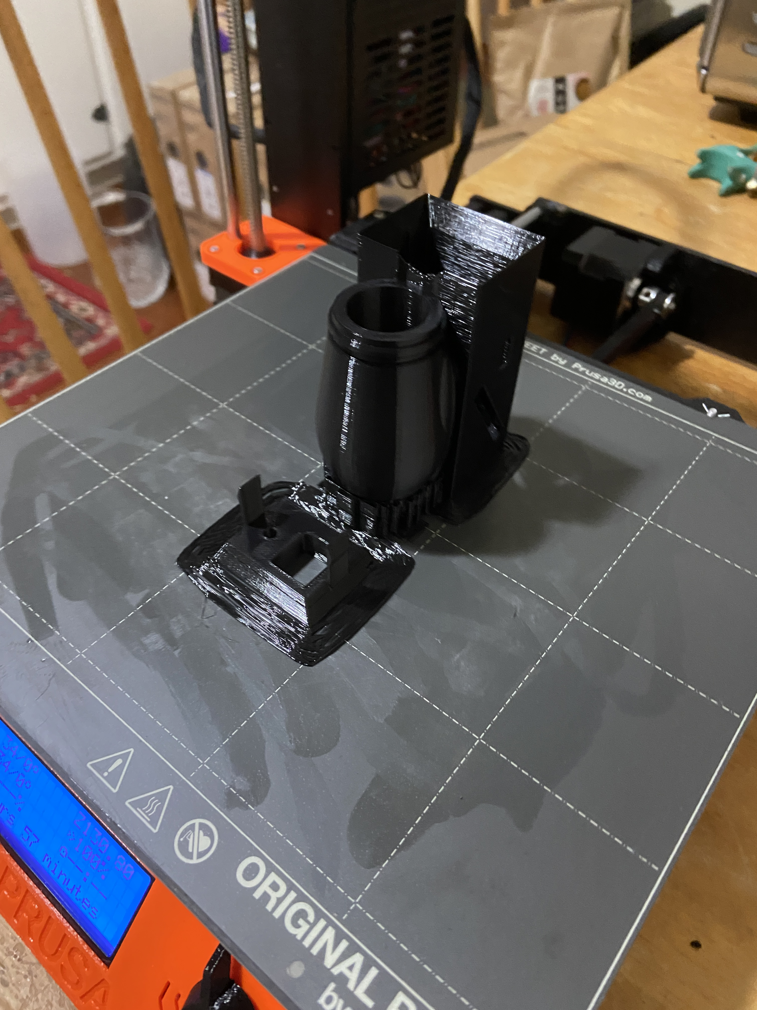
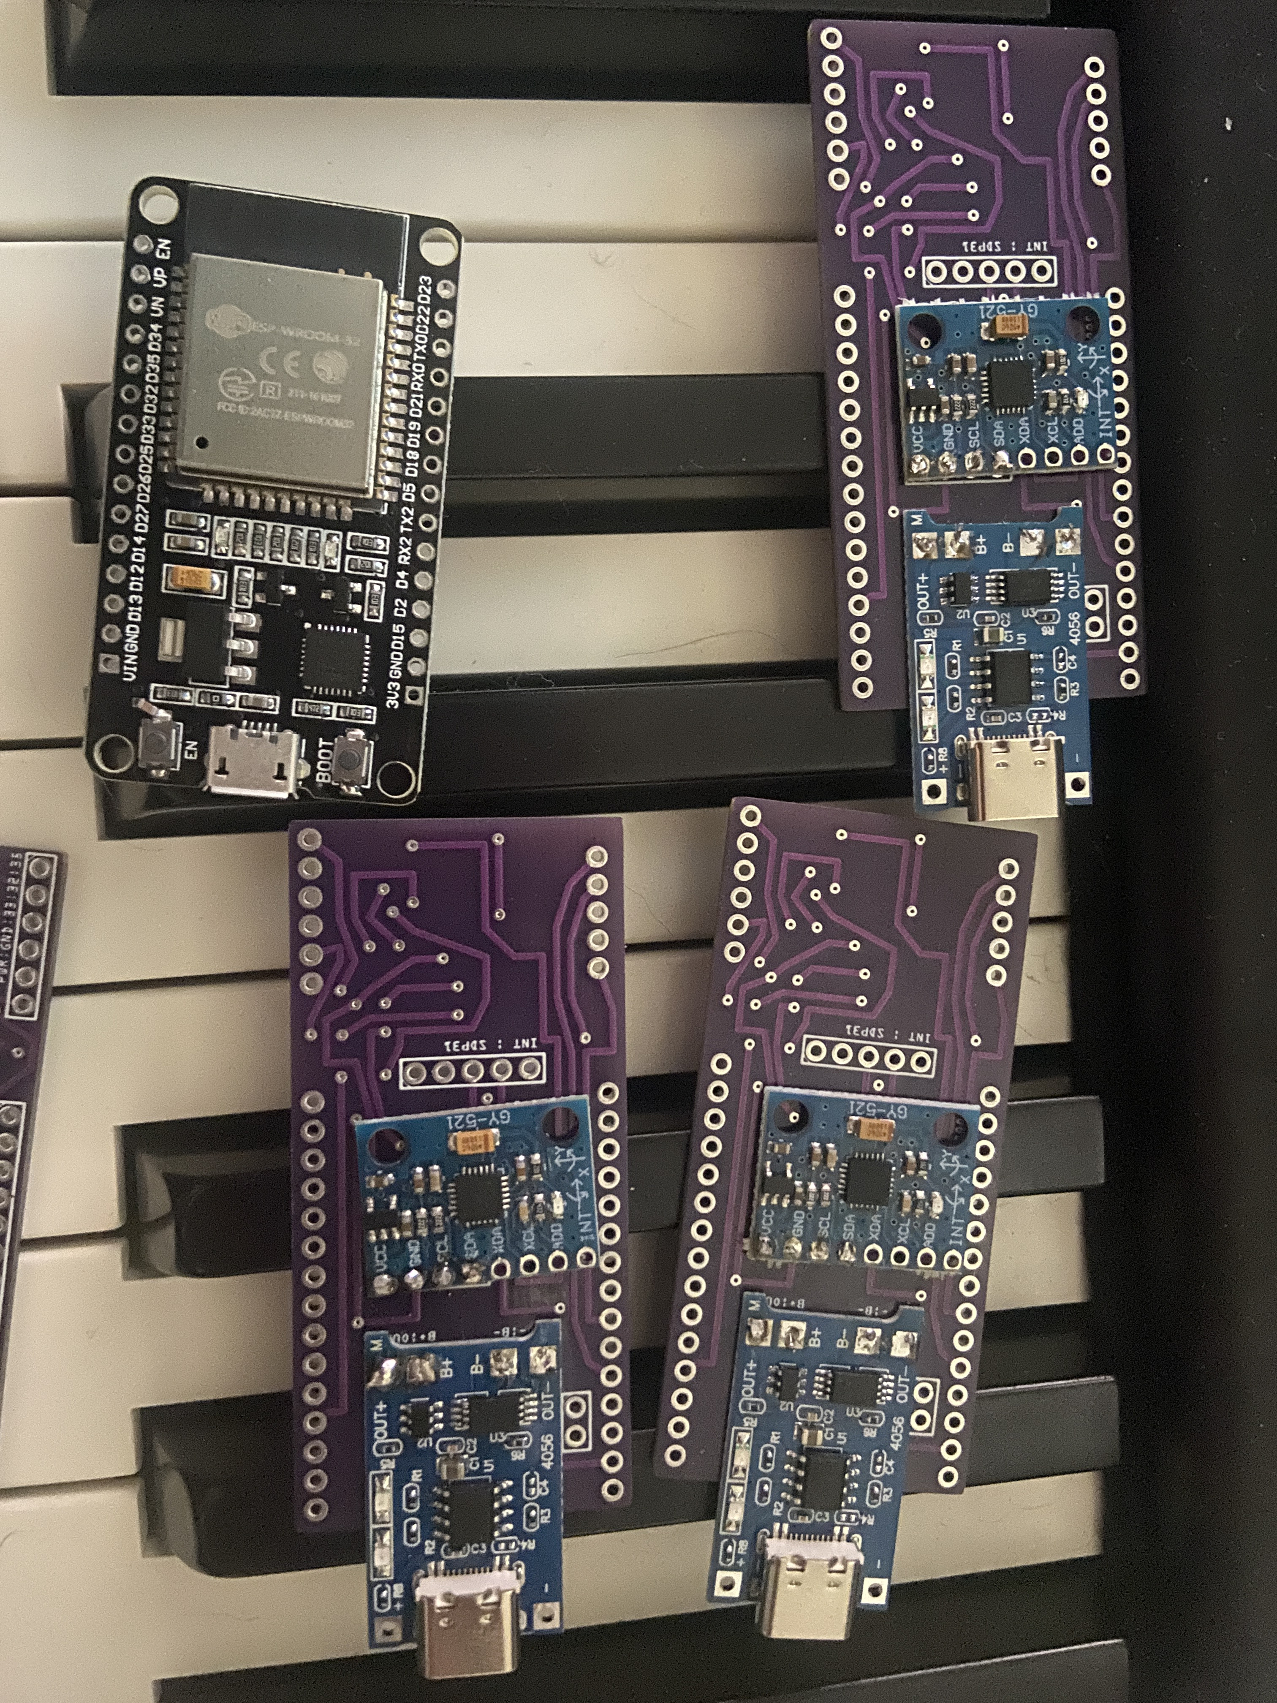
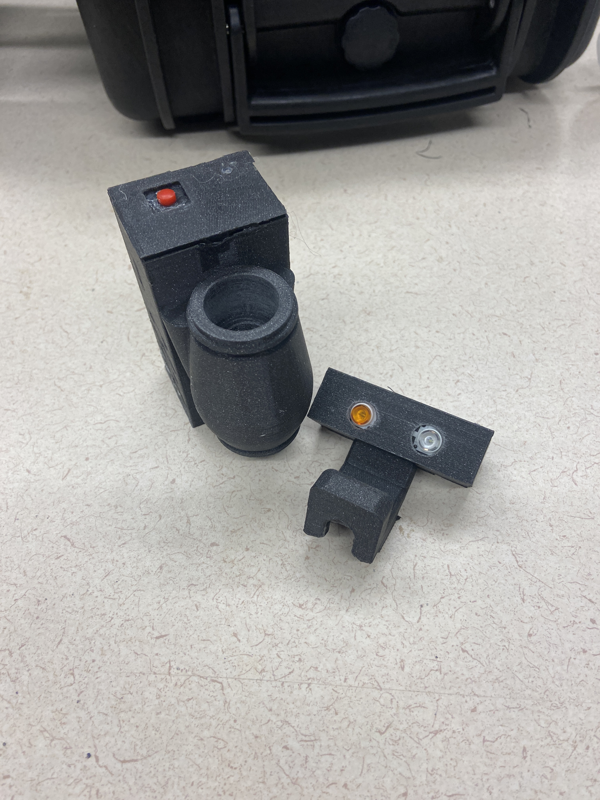
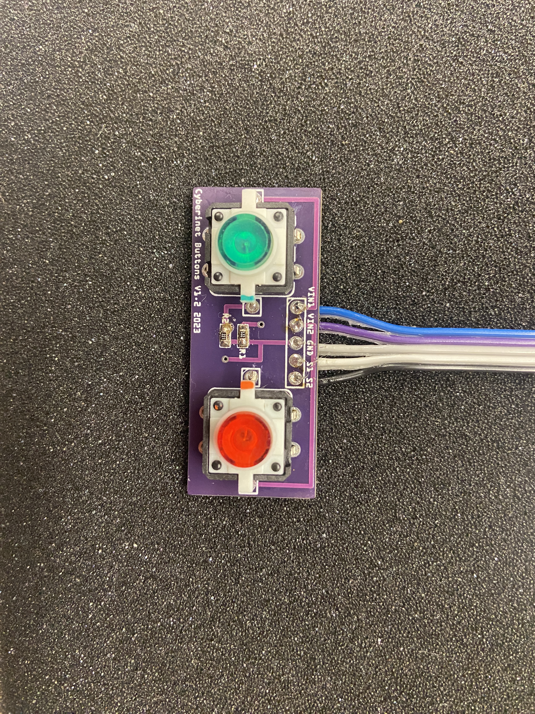
Version 1 with Button Board
Notes:
Full unit is approximately 62x30 mm (2.4x1.2in)
Building units
Case draft on 3D printer
Completed unit on right
Now we have talked about what the Cyberinet it, and How its made. So lets look at…

Slide 25
How the Cyberinet works
Notes:
Three main categories:
Collect Data
Transmit Data
Apply Data

Slide 26

Collects data
The Cyberinet’s .ino code and attached sensors manage the collection of the performance data.
SDP31: Measures differential air pressure between the inside and outside of the instrument. Small tubes connect to the sensor to facilitate this. Also measures temperature.
MPU6050: Measures performer movement in 6 axis.
Buttons: triggerable by the performer.
Other Expansion Add-Ons.
Notes:
Microcontroller manages Sensor Data.
Programmed using the Arduino Language and IDE

Slide 27
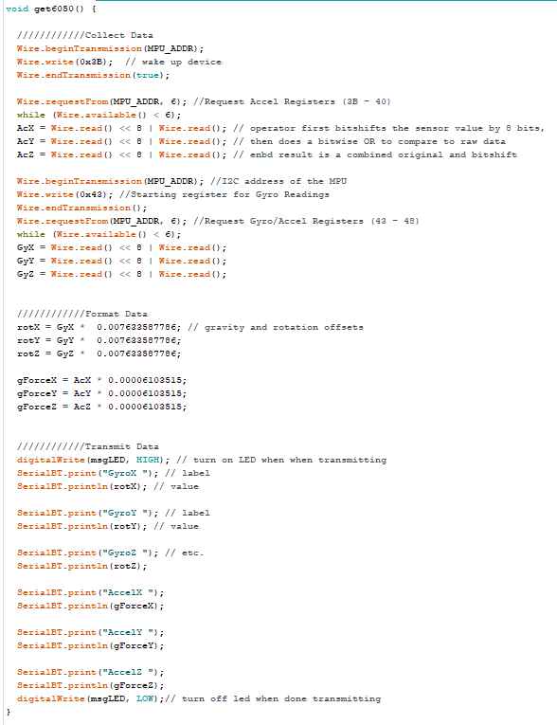
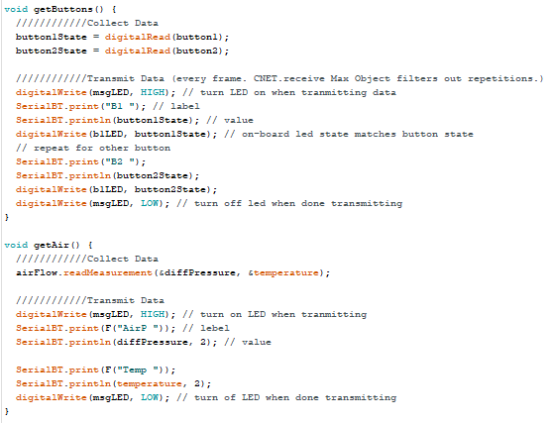
Data Collection Code
Notes:
Each function collects and transmits data.
Contact sensor
Read data
Gyro has scaling for gravity and earth rotation
Transmit data via serial communication
LED turns on to indicate transmitting

Slide 28
Transmits wirelessly
The main unit’s ESP-32 board the transmitting as well as the data collection.
By utilizing the Arduino library “BluetoothSerial” the DEVKIT can transmit serial communications through a Bluetooth connection. The device name is “CyberinetV1X” and currently requires no password to connect.
These values can be read by any serial terminal program on the host device. The Max objects utilize an additional node script to receive the data more reliably.
Notes:
Adds label to value and transmits them as a pair. Can be read by anything that can receive serial data.

Slide 29
Performer Opinions
We will take a few moments to ask Adam about his thoughts with using the device.
What are your honest opinions on the usability, flexibility, and anything else you would like to mention?
Notes:
Before the next music example.

Slide 30
Music

Slide 31
Ethereal Presence (2022)
Utilizes gyroscope and airflow sensors.
As the performer moves, the position of their instrument changes the pitch content of the accompaniment.
Computer synthesis has 2 main textures:
Filtered pink noise to provide backing texture
Modified FM synthesis to provide accompaniment to the soloist
Music alters between different styles to encourage a variety of performance movements.
Wide tempo variety helps encourage a non-identical performances.

Slide 32
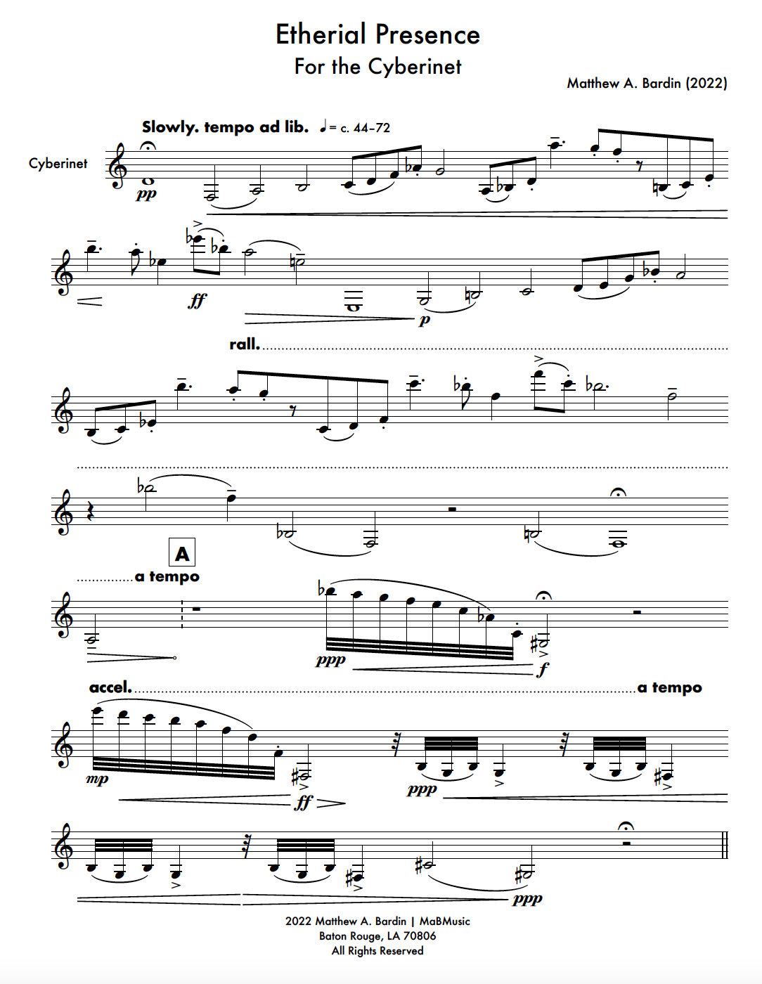
Adam Cope- Cyberinet
Ethereal Presence opening page

Slide 33

Computer Processing
Notes:
Final Large section of the presentation

Slide 34
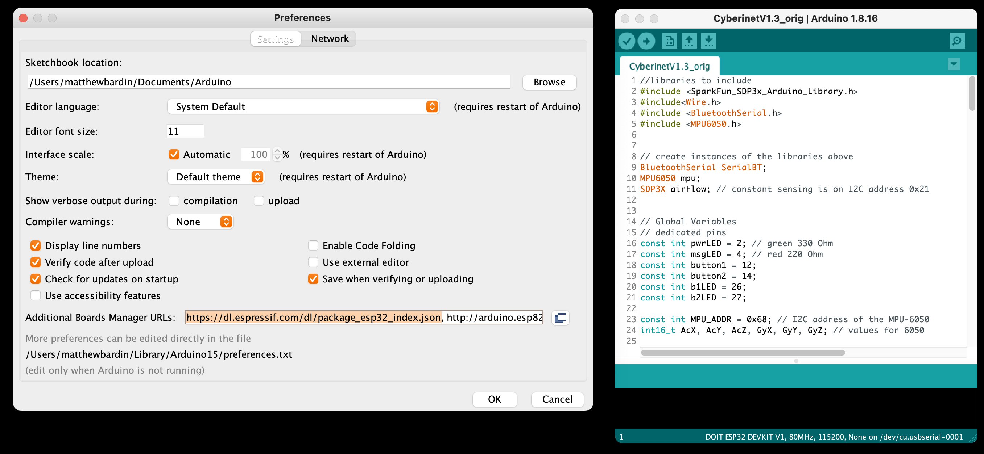
Driver Installation
A few drivers are needed to utilize the ireless communications.
ESP-32 Drivers: These can be easily installed via the Arduino IDE program.
Node and NPM: Can be installed from the Node website and managed via the Terminal.
These extra steps only need to be run once, whenever it is the first time a computer has paired with a Cyberinet.
NPM can be managed from the Max objects as well.
Looking to streamline this step in future revisions.
Notes:
Looking to streamline this step in future revisions.

Slide 35
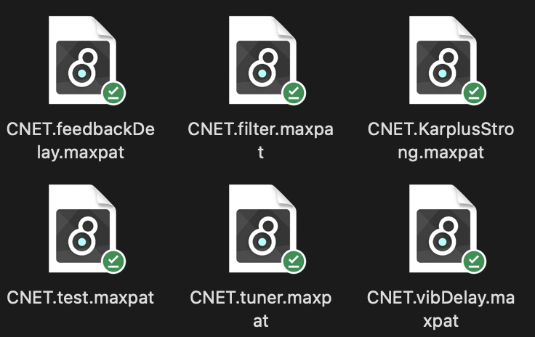
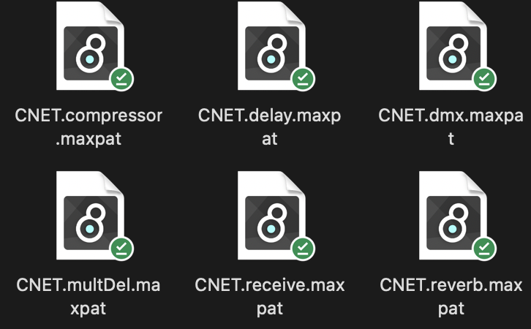
Processing/Manipulation in Max
The main goal of the Cyberinet is to collect and transmit the sensor data.
From there it is largely up to the user to decide what they want to to with the data.
To help with that I have also created a series of Max patches that can be used to control various elements of a Max patch including:
Reverb
Various Delays
Gain
Debug testing tool
Tuner
Playback Control
DMX Control
More coming soon!
Early effects are simpler alterations to the Clarinet’s sounds and software control. More complex uses to come as the hardware continues to be refined.
Notes:
More slight alterations to the sound and simple effects for now.
All patches have the CNET prefix.
A few screenshots of the audio effects are in the same folder as the program.

Slide 36
QR Code reminder
You can find screenshots of a selection of max patches here.
I’ll keep this up for a few seconds if anyone needs it.

Slide 37
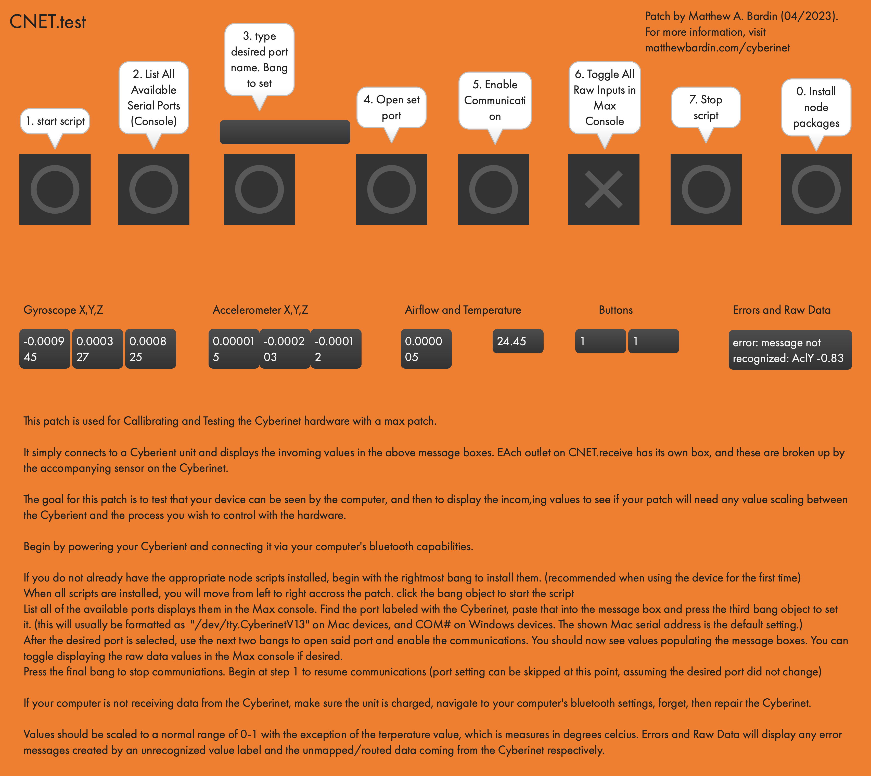
Max Patches Continued
CNET.receive receives all the data from the Cyberinet, sorts and scales it for use, then outputs the numbers to unique object outlets.
Port defaults to the expected MacOS formatting. If everything matches, steps 2 and 3 can be skipped.
Notes:
Designed to walk the user through the steps of connecting and communicating with the Cyberinet.
Only need to install the node elements the first time, which is why it is labeled as step 0.

Slide 38
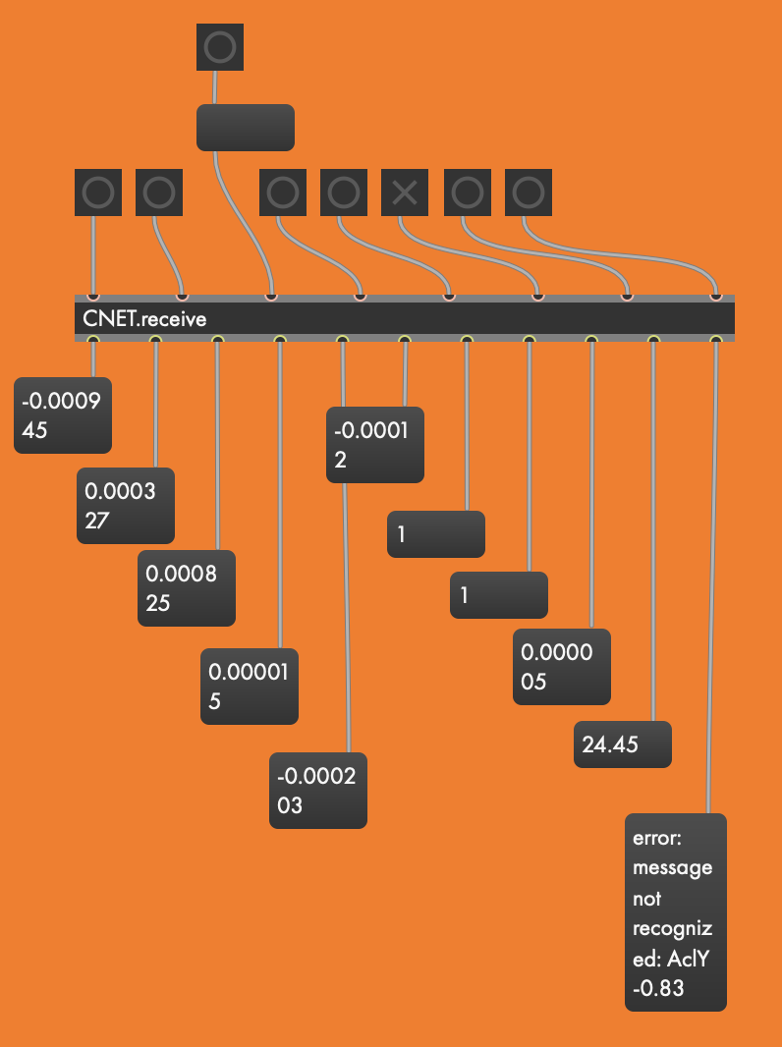
CNET.receive
Notes:
Implement the CNET.receive object to utilize Cyberinet in any max patch.
Can be put into any max patch.
Values are scaled from 0-1 except the temperature.

Slide 39
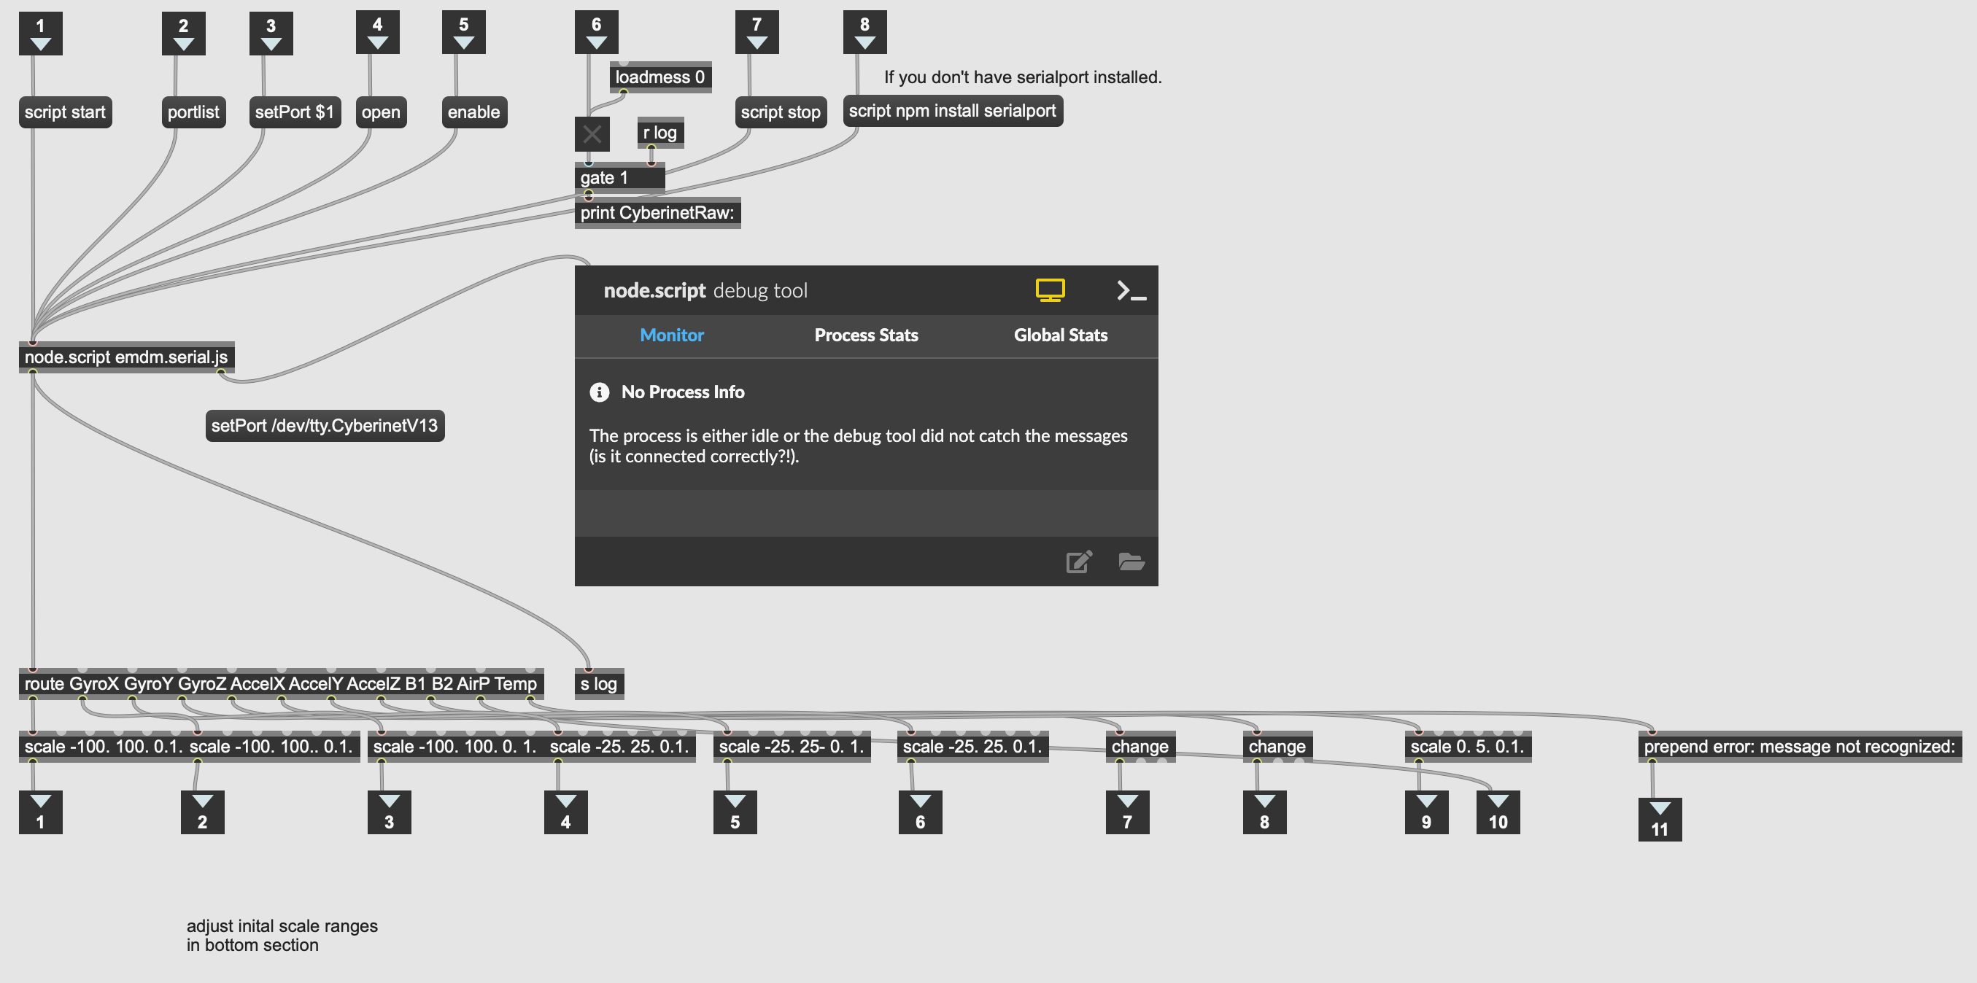
CNET.recieve patch inner workings
Notes:
Inside CNET.receive
Bangs and toggles to the inlets set the values.
Intended to remove the need for memorizing specific message commands.
Values are received, sclaed, and output from the corresponding outlet.

Slide 40

Sending data to other programs
Data from the Cyberinet can be read by any Serial Monitor.
Data is formatted for Max by default.
Programs like Max can then convert the messages to different formats and transmit them to other devices and software as needed.
Notes:
Cyberinet is intended for use with Max but is not paired to it. Can be used with any program that can access serial communications.

Slide 41

Online Resources
Notes:
Were can you find the resources?

Slide 42
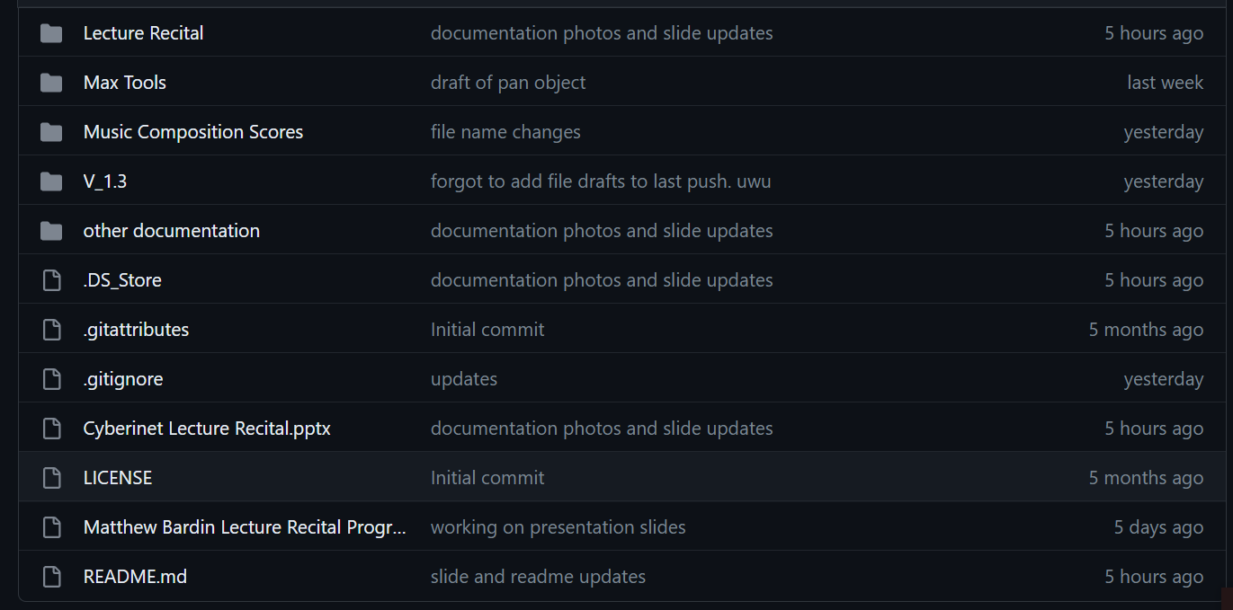
Github Repo
github.com/mbardin/Cyberinet
Contains all code, diagrams, and other information
Notes:
QR Code from earlier directs to a folder in the github.

Slide 43
Code, Patches, Diagrams, & Resources.
Cyberinet units will be available for purchase at a future date.
All materials are open-source.
A person can build their own unit using the online resources.
Notes:
Similar to Arduino. Products can be made with sufficient materials and skill, but purchasing will support future development.

Slide 44
Music
Notes:
Final music Performance.

Slide 45
Raindrops on a Tin Roof (2022-2023)
Utilizes all the included sensors:
Gyroscope/Accelerometer
Airflow
Buttons
The performer cues up various sound files and musical sections using the buttons.
Other sensors are used to control the processing of the sounds.
Sounds range from relaxing to extremely chaotic.
Text by Matthew A. Bardin

Slide 46
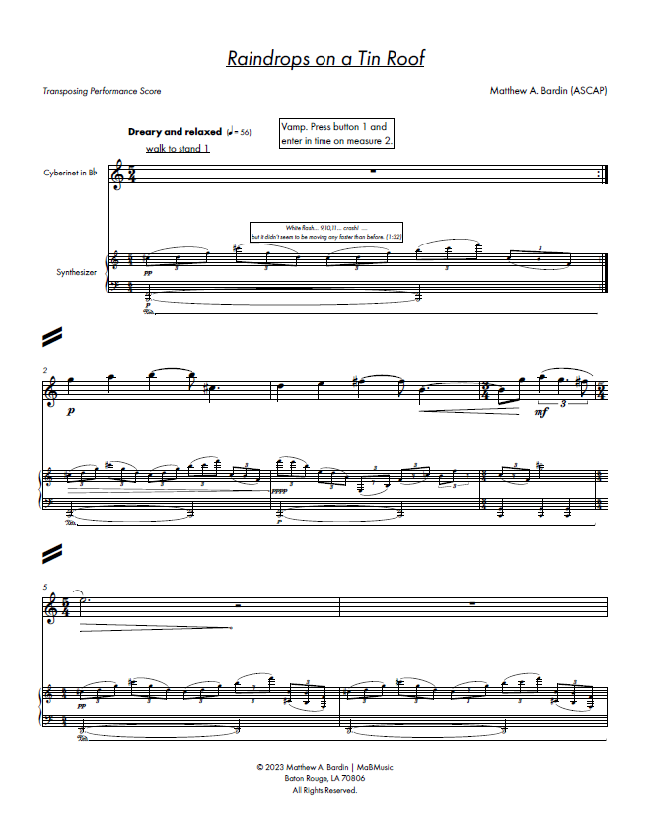
Adam Cope - Cyberinet
Matthew Bardin - Narrator
Raindrops on a Tin Roof
opening page

Slide 48
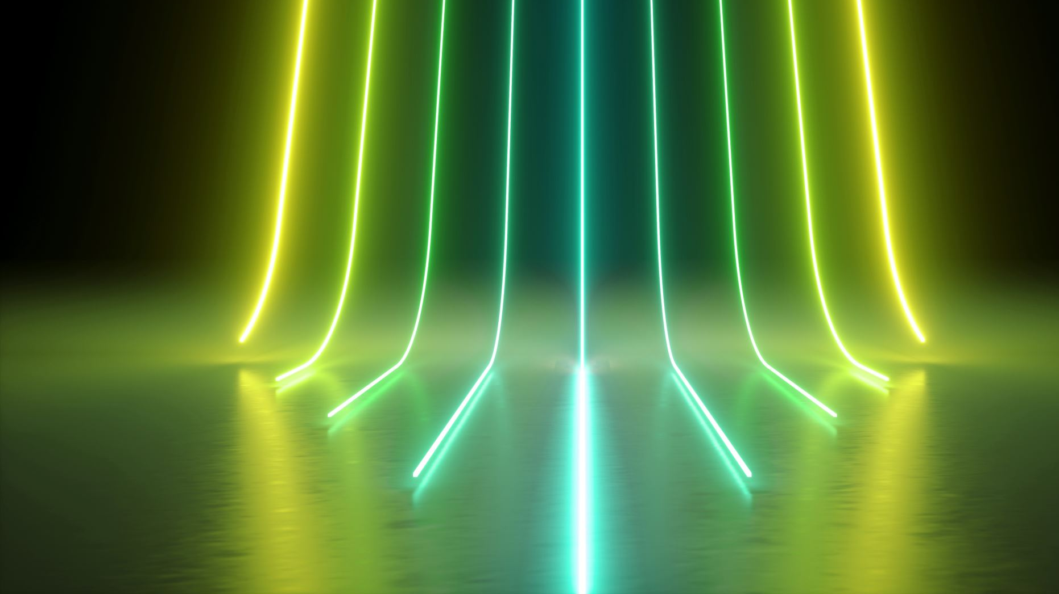
Future Directions

Slide 49
Potential Future Directions Include:
Optimal serial communications and installations for Windows and Mac operating systems.
Completing and refining the options for expansion units.
Custom-made PCBs without OEM to make smaller units.
OSC Formatting for easier multi-platform use cases.
Permanent embedding within a clarinet.
Making versions for other instruments.
Password locking units to avoid miss-connections.

Slide 50
Final Notes

Slide 51
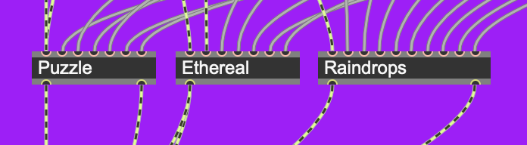
All the compositions are available in Max.
50
Each of the patches used to make these performances has been created as an object in Max. Performers can download these from the GitHub repo for performance, or experiment with their own processing.
Scores, patches and other info available at matthewbardin.com

Slide 52

Questions?

Slide 53

Thank You for coming!

